Slide 1






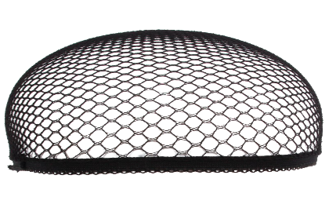












Making ents
Make ense

Slide 2











Rise To Your Role
Food Service
Manager
Chef
Active
Listener
Food
Inspector
Financial
Officer
School Food Authority
Notes:
Your more then a lunch lady or lunch man. You’re a food service professional, a business owner, advisor, and inspiration to your community. So, when you walk into your kitchen door be inspired, and motivated to accomplish the days mission of “Nourishing Children To Achieve Excellence”.

Slide 3

Café LA Compass
Forecasting
&
Ordering Food
Receiving
Accurately
Financials
&
Managing
Budgets
Meal Counts
Managing Inventory

Slide 4
Financials
&
Managing
Budgets

Slide 5




Financial Literacy
Revenue
Costs
Net-Income
Is the total income earned, before any expenses are subtracted.
All costs required for the business to operate.
Amount of revenue after all costs are paid in full.
(Total Revenue) – (Costs) – (Operating Expenses) = Net-Income

Slide 6
Revenue
Revenue is the total income earned, before any expenses are subtracted.
Forms of revenue for Café LA food service operations
USDA Federal Funding
Reimbursement Rates
  Breakfast, Lunch, Supper, Snack
Paid Meals
  A La Carte, Catering
Commodity Food program
  Funding from congress for low income
  or Government food wholesaling
Excess Farm Food
State Funding
Reimbursement Rates
  Breakfast, Lunch, Supper, Snack
Offsets district costs
Grants
Farm To School
K.I.T. Funds

Slide 7










Meal counts are submitted to State and Federal government for reimbursement.
FSD funds are used to pay for food, supplies, labor and benefits.
State and Federal funds are received.
Students receive reimbursable meals.
Meals are entered in MCS FOH.
Notes:
TELL: It is important to input meal counts into CMS daily in order to make a timely reimbursement claim.
(Click and read each step)

Slide 8
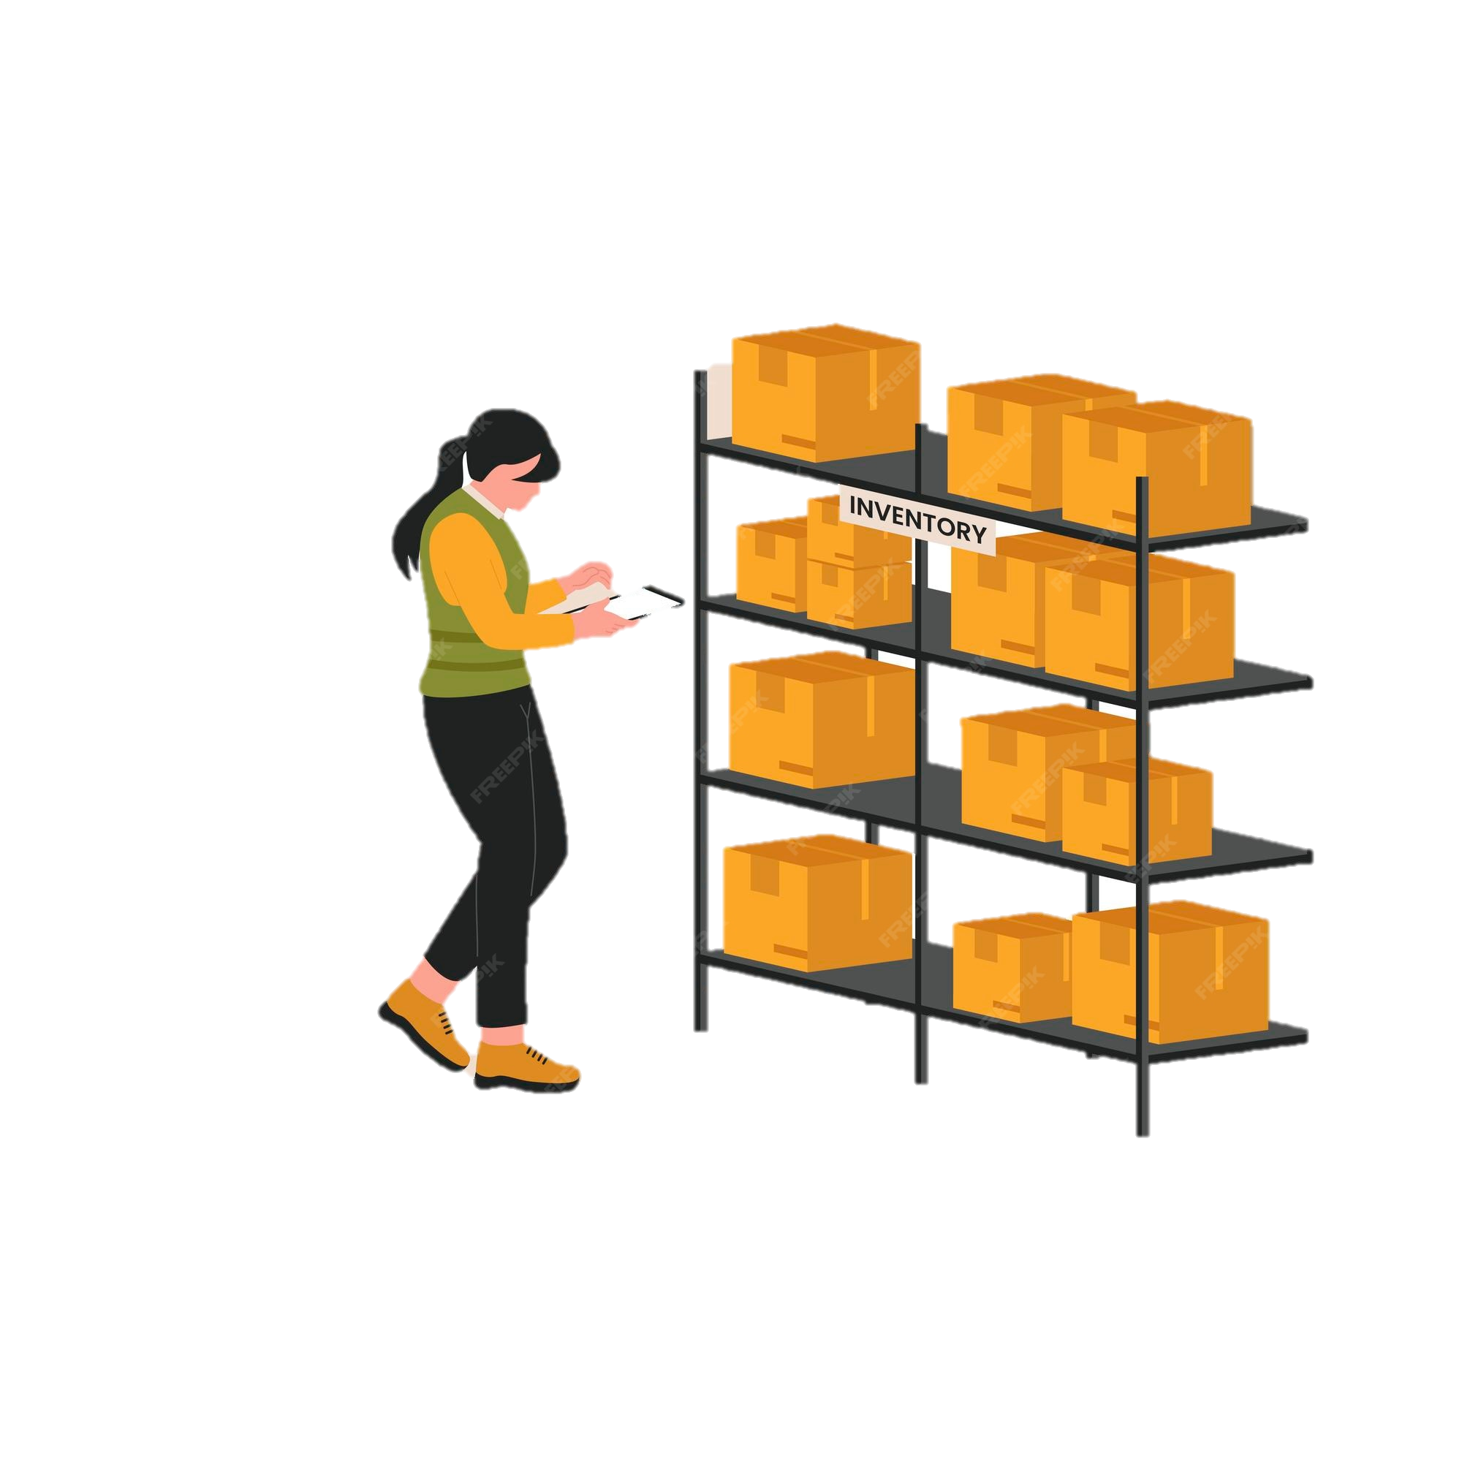
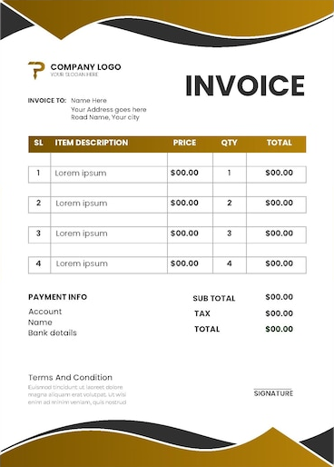


Understanding Food Cost
Food cost is the expenses related to ingredients and inventory used in
preparing food and beverages for sale.
Calculating food cost is food usage compared to weekly revenue.
Stock
Stock
Opening inventory + Purchases - transfers out + transfers in – Closing inventory
Formula: (Food Cost÷Revenues X 100) =Food Cost %
Notes:
Important to know it both as a total $$ amount and as a percentage (%).

Slide 9

Calculating Labor Cost
Labor is a fixed cost in school food operations and is paid for by the revenue generated from claimed reimbursable meals.
Increased participation can result in better management of labor cost.
Formula: Labor Cost %= (labor cost÷revenues x 100)
Formula: Labor Cost $= (wages÷salaries + fringe benefits)

Slide 10

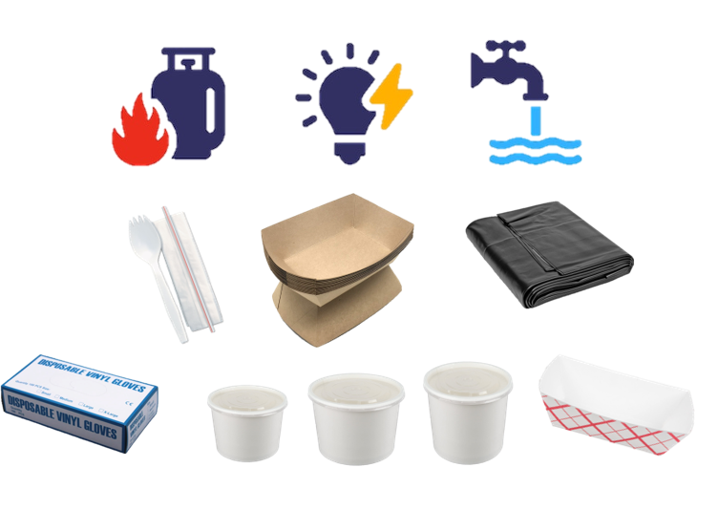


State and Federal funds received as Revenue is used to pay for costs:
Food
Supplies & Utilities
Overtime
Substitutes
Medical
Vacation
Additional
Time
Hourly
Wages
Illness
Training
Benefits
Fringe Benefits
Labor
Notes:
When an employee is out ill we pay for two employees on the same day being a substitute and illness hours for permanent employee

Slide 11


Weekly Budget
Weekly budgets are based on the individual cafeteria sites average weekly participation for; breakfast, lunch, supper, and snack.

Slide 12




Communication
Communicate with the Area Food Service Supervisor (AFSS) on any impacts or fluctuations to the weekly budget, such as; adjusting a shopping list to a previous week or catering for an event at your school site.

Slide 13
Meal Counts = Revenue
School food programs receive reimbursement rates from both the federal and state governments, with the specific amounts varying based on meal type, student eligibility (free, reduced-price, or paid).
Notes:
Breakfast reimbursement rate is based on “severe breakfast need” reimbursement rate from CNIPS. Most of our schools serving breakfast qualify under that reimbursement rate.

Slide 14
Increasing Meal Counts = Increased Revenue
3 more breakfast, lunch, and suppers
682 cafeterias
Yields 6,138 meals per day
Generates $3,266,643.60 of additional revenue
Notes:
Breakfast reimbursement rate is based on “severe breakfast need” reimbursement rate from CNIPS. Most of our schools serving breakfast qualify under that reimbursement rate.

Slide 15
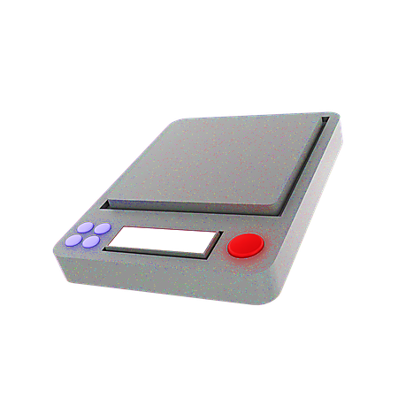


How FSMs Impact Meal Counts
The FSM’s responsibility is to manage the operation and to provide students with nutritious meals that they want to eat.
There is a dual responsibility; be in compliance and financially solvent:
Increasing meal participation
Managing cost per meal
Reduce waste

Slide 16
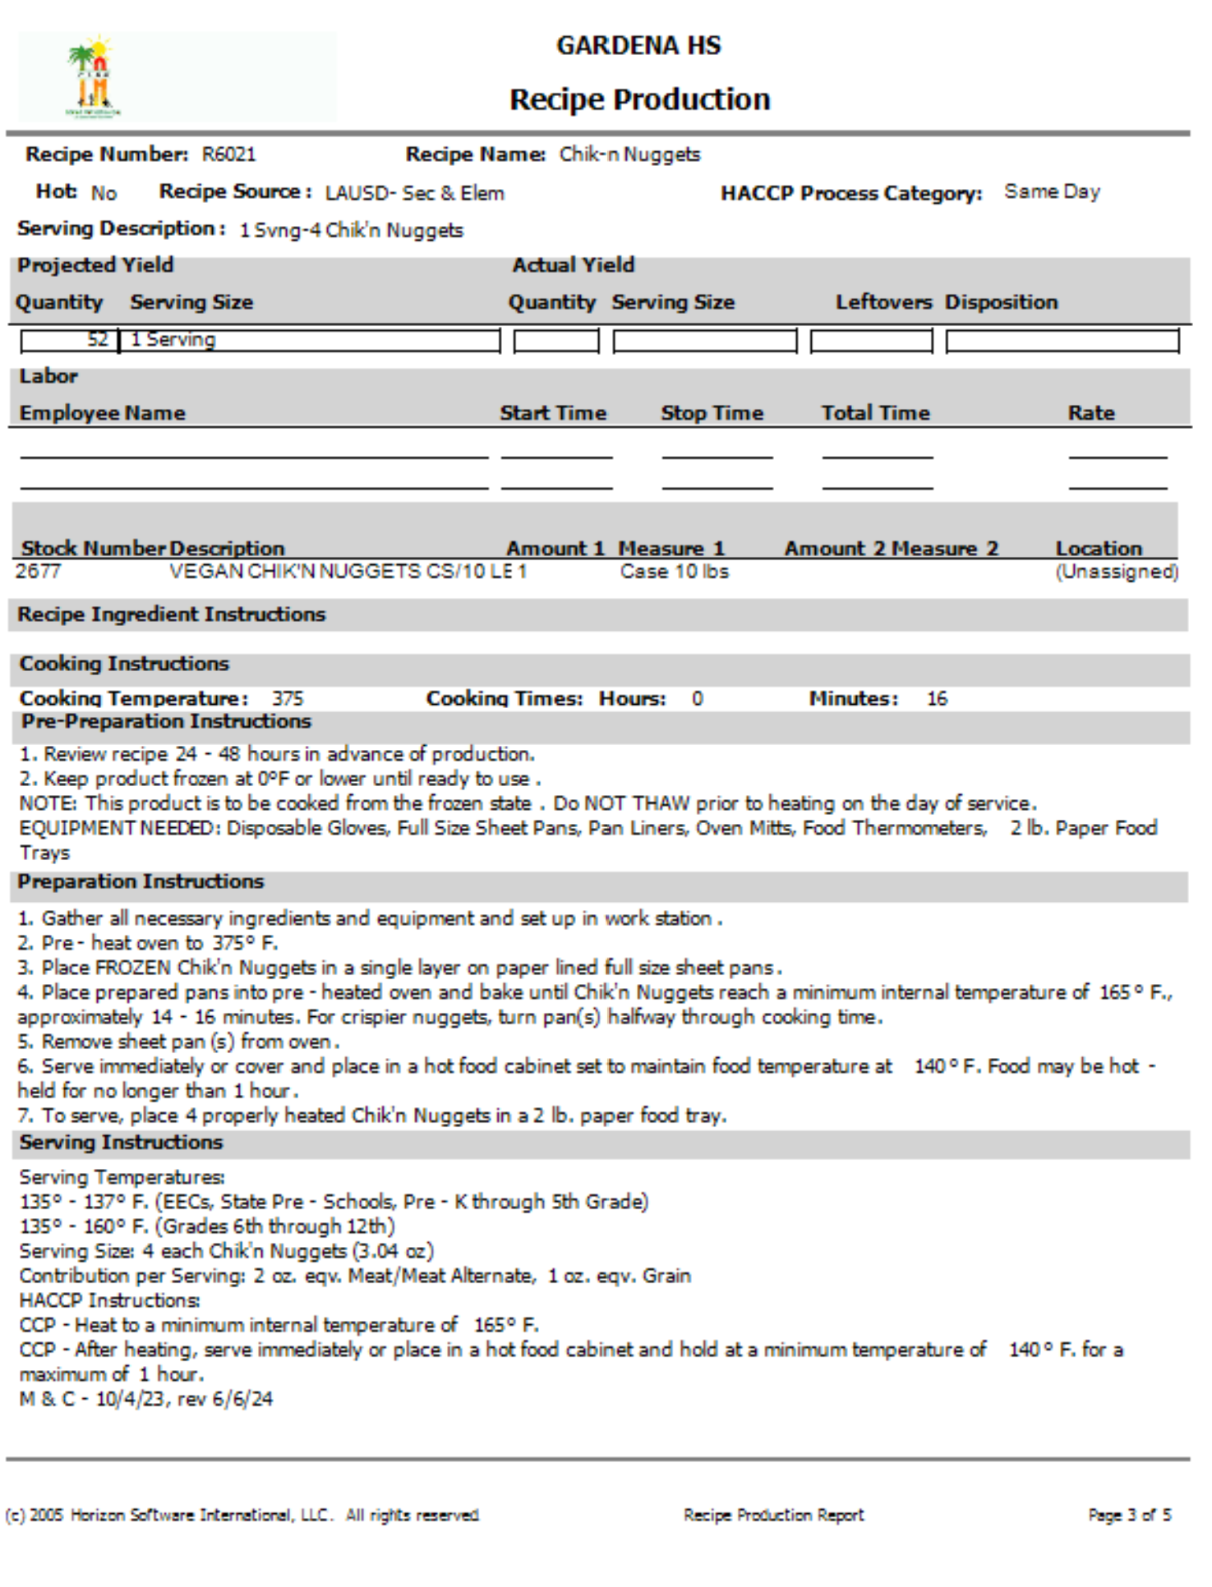

Adhering To Standardized Recipes
Adhering to standardized recipes guarantees each reimbursable meal served meets specific USDA and CDE nutritional requirements and aids in controlling:
Supply cost
Food cost
Portion control
Utilize the Gold Standard to ensure consistency in meal preparation.
Notes:
Procurement is the process of acquiring the goods, services, or works needed by an organization, typically from external sources like suppliers or vendors. It encompasses everything from identifying needs to managing supplier relationships, ensuring the organization receives what it needs at a reasonable cost and with the right quality.

Slide 17
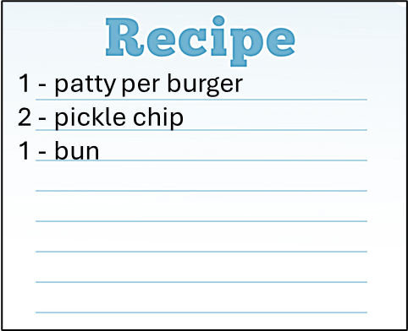







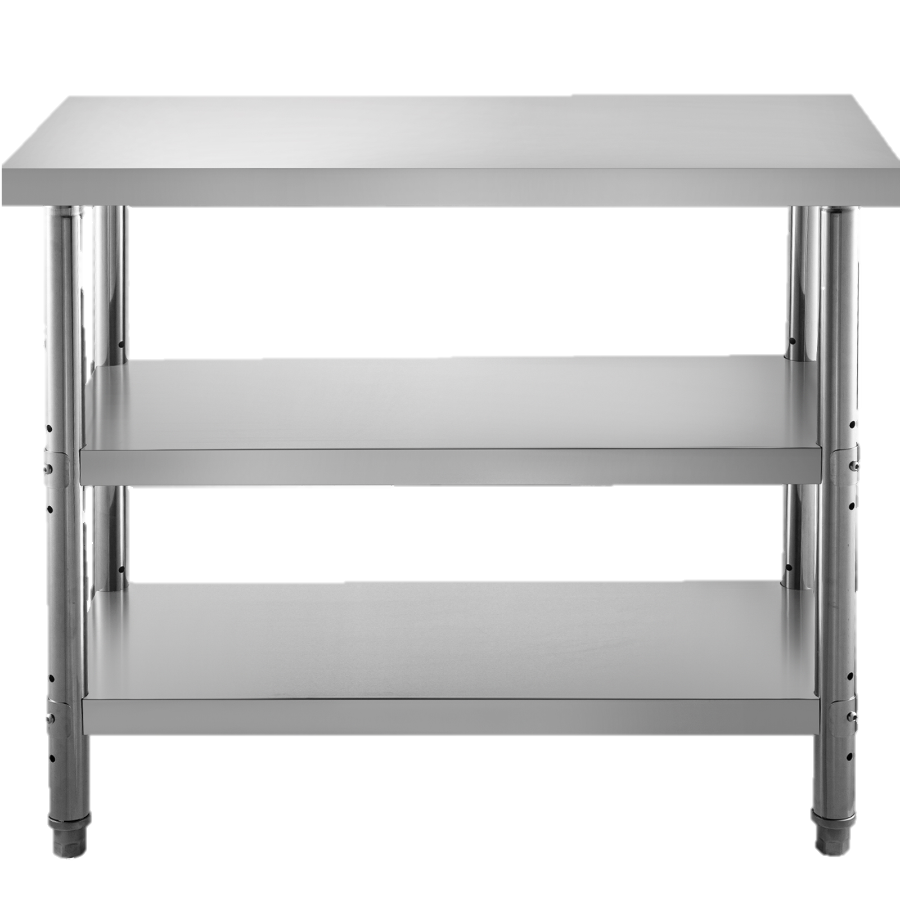
Can A Pickle Chip Affect The Bottom Line?
McDonalds hamburger recipe calls for 2 pickle chips.
The employee use 3 pickle chips.
Pickle chip, 1 each = $.005
412 hamburgers prepared x $.005 = $2.06
108 stores x $2.06 = $222.48
$222.48 x 365 days = $81,205.20
Total annual cost of not following the recipe
$81,205.20

Slide 18
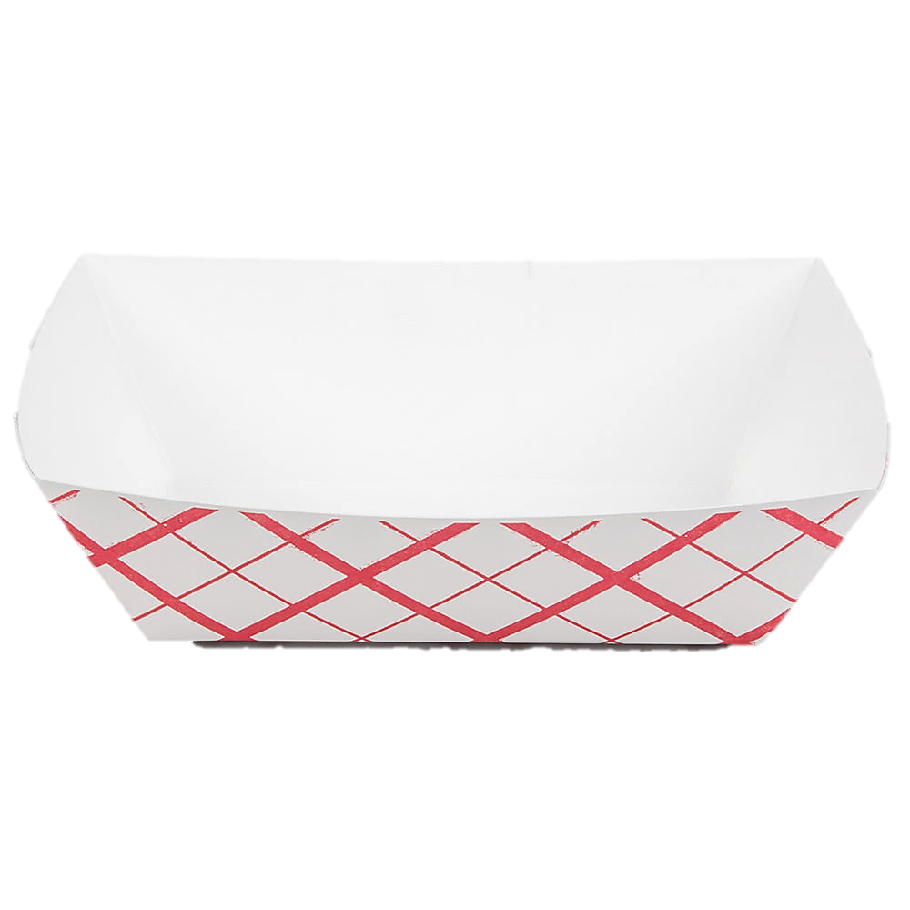
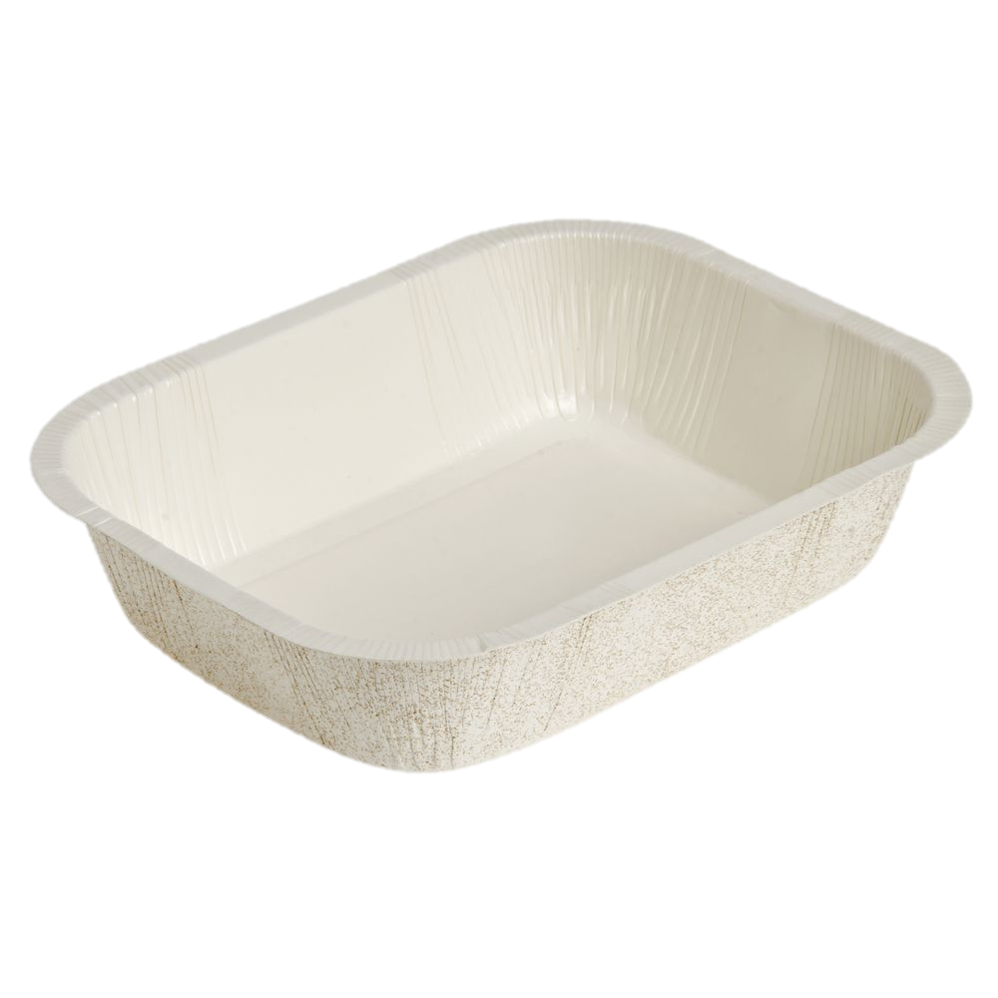
Comparing Supply Costs
Following standardized recipes supports food and supply cost management.
2 lb. Tray
Ovenable
1 Case (1000) - $30.60
1 2lb. Tray = $0.0306
1 Case (2990) - $191.65
1 Ovenable Tray = $00.0641
500 servings x $0.0306
15.30 x 180 school days
$2754 supply cost
500 servings x $0.0641
32.05 x 180 school days
$5769 supply cost
Notes:
Procurement is the process of acquiring the goods, services, or works needed by an organization, typically from external sources like suppliers or vendors. It encompasses everything from identifying needs to managing supplier relationships, ensuring the organization receives what it needs at a reasonable cost and with the right quality.

Slide 19


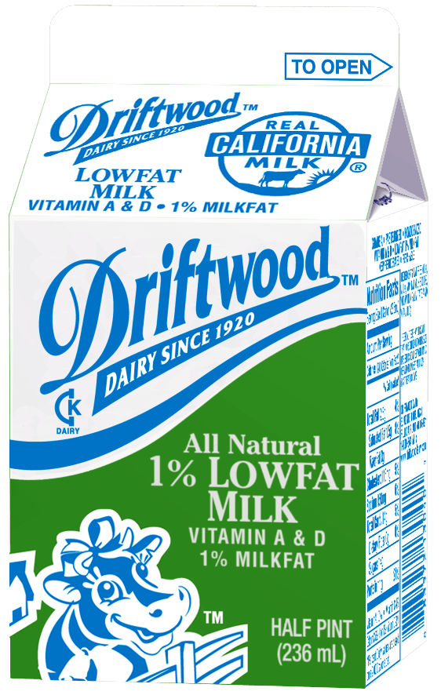



Increase Nutritional Access
Students who bring food from home can supplement their lunch with locally grown fresh fruits, vegetables, and an ice-cold milk. These meals are reimbursable, boosting participation and ensuring all students can share the same experience of visiting the Café LA.

Slide 20
Financials
&
Managing
Budgets
Forecasting
&
Ordering Food

Slide 21


What is Forecasting?
Forecasting is the process of predicting future outcomes based on past and present data, using patterns and trends to make informed estimations about future events or conditions.
It’s a crucial tool for businesses to anticipate changes in key indicators like sales, customer behavior, and market trends, enabling better operational and strategic decisions.
Notes:
Your Cafeteria Info sheet should be updated yearly or as average daily participation

Slide 22
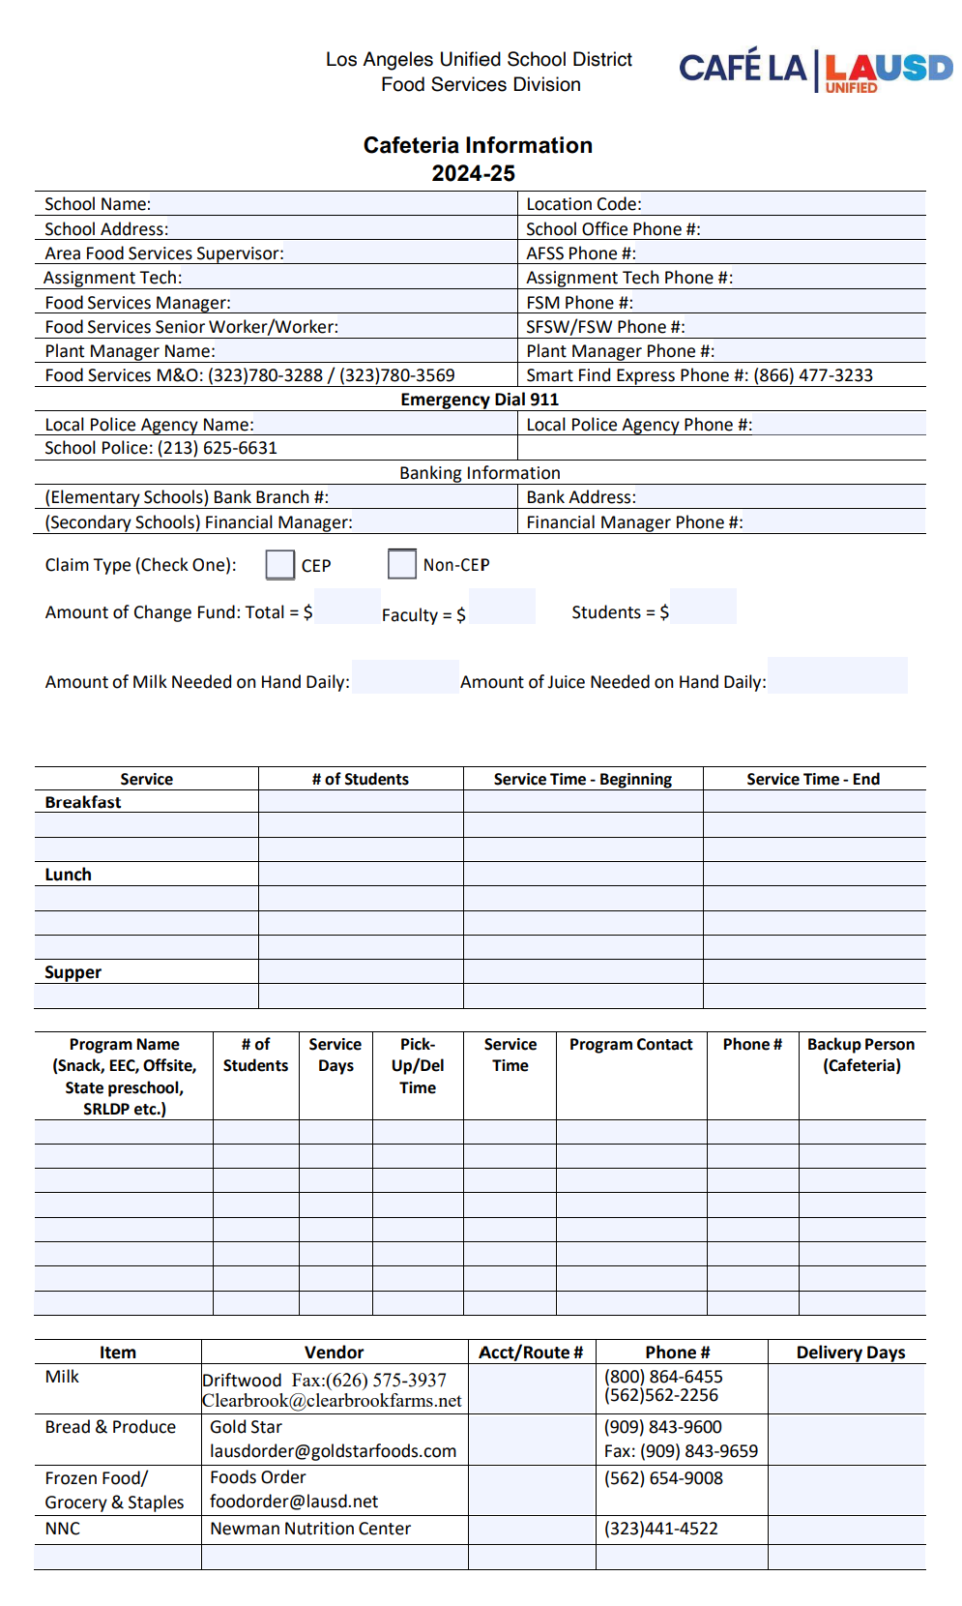
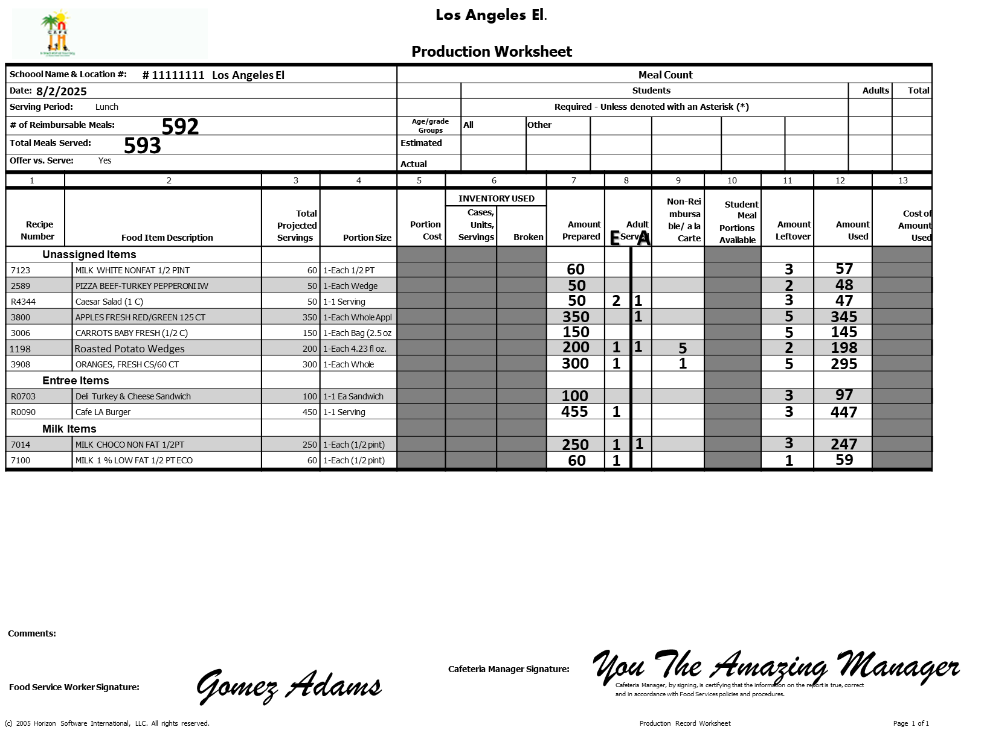
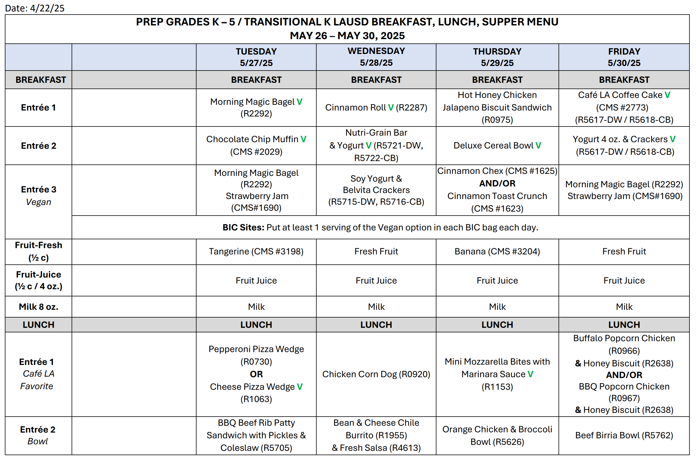
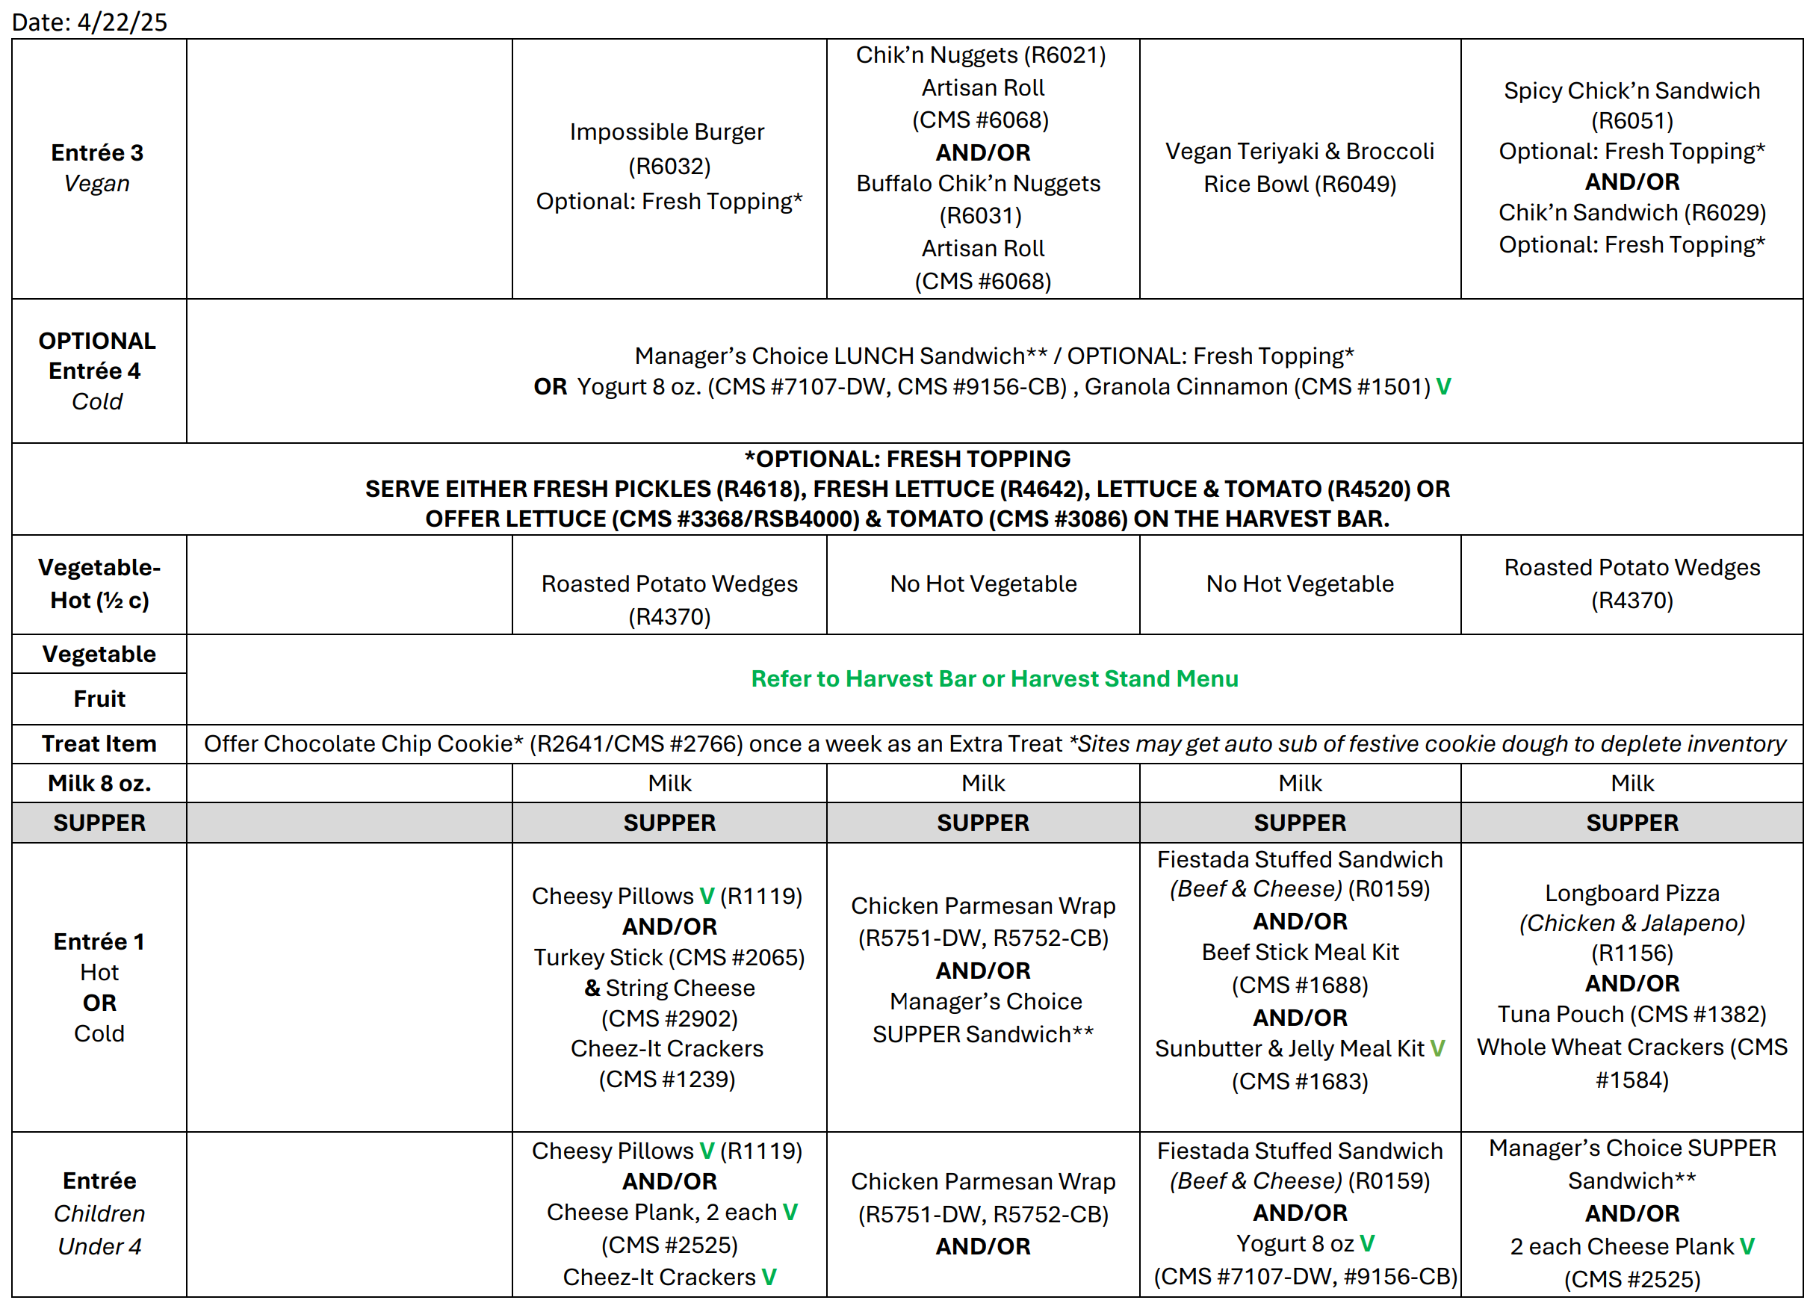
Forecasting Tools
When forecasting, utilize available tools and past information to avoid inaccuracies in ordering and food production.
Cafeteria Information Sheet
Update the Cafeteria Information Sheet every year to reflect meal participation. This is a useful tool used for forecasting.
Production Worksheet
Review past Production Worksheets and weekly menus for forecasting patterns amounts served and leftovers.
Menus
Use the menu to plan out preparation/serving quantities based on student preferences.
Notes:
Your Cafeteria Info sheet should be updated yearly or as average daily participation

Slide 23






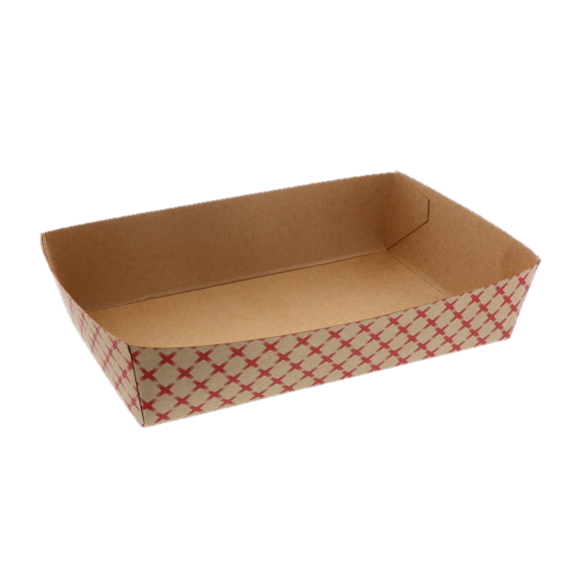
Impacts To Forecasting

Slide 24
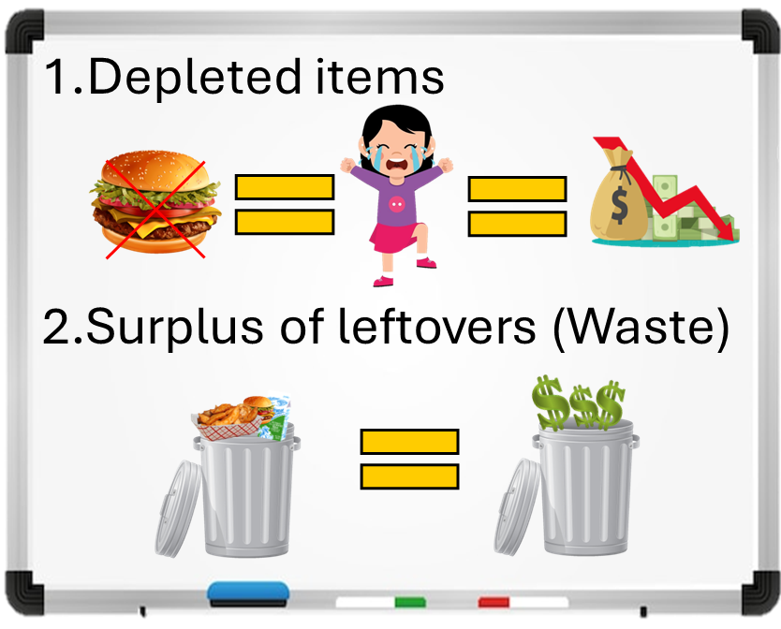
Inaccurate Forecasting
Inaccurate forecasting can lead to several negative outcomes that affect financial performance, operational efficiency, and student satisfaction.
Food waste
Nutritional gaps
Financial Losses
Compliance risks
Inventory imbalance
Operational disruptions
Shortages and student dissatisfaction

Slide 25




Inclement Weather
Sudden changes in weather can impact forecasting and food cost, often leading to increased participation. Factor this in when planning menus during inclement weather.
Rainy Days
Hot Days
High Wind
&
Poor Air Quality
Rainy day schedules require indoor dining, which often leads to increased student participation.
Extreme heat may cause students to seek air conditioned or shaded dining.
When air quality alerts are in effect, adjust your forecasts accordingly to meet increased demand and avoid shortages.

Slide 26







Field Trips, Celebrations/Holidays & School Events
Field trips, celebrations, holidays, and school events can impact forecasting, consider implementing different marketing tools to boost participation.
Field Trips
Celebrations / Holidays
School Events & Student Clubs
Maintain revenue and student participation, by maximizing field trip meal opportunities. Reach out to school administration on a monthly basis.
Conduct
PA announcements to encourage students to pick up a Café LA kit as a nutritious complement to their holiday or celebratory snacks.
Actively build rapport with students during school events by staging mobile carts near events to reach potential customers. Create a speed line for clubs.
Notes:
Your Cafeteria Info sheet should be updated yearly or as average daily participation

Slide 27


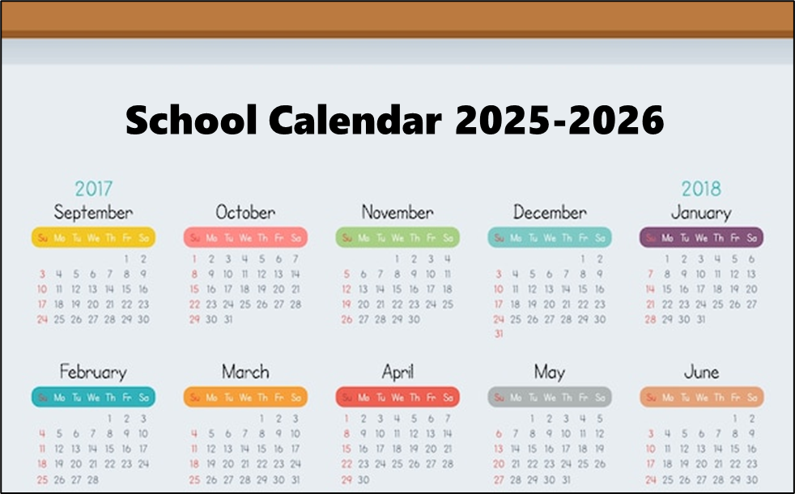



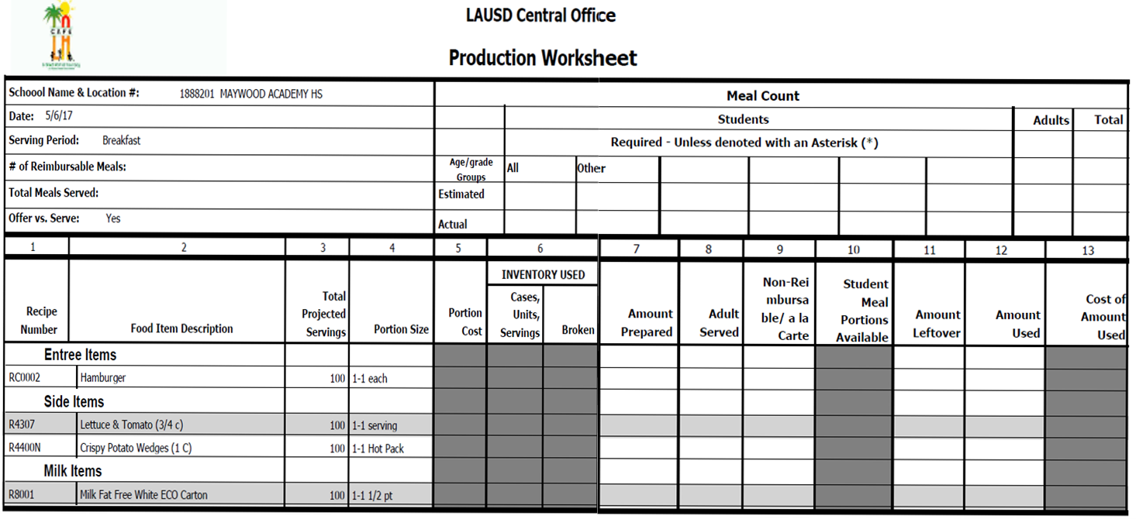

Early Dismissal/ Minimum Days
  Early dismissal and minimum days can impact lunch and supper meal program participation. Adjust food orders, meal preparation, and staff scheduling accordingly.
  Conduct PA announcements to encourage students to visit Café LA to receive a meal before they end their day.
Notes:
TELL:

Slide 28


Accurate Forecasting
Accurate forecasting and adjusting meal plans based on inclement weather, field trips, and holidays/celebrations results in:
  Lowered food cost
  Satisfied customers
  Eliminating food waste
  Ordering correct amounts
  Consistency in food operations
  Compliance with USDA and CDE

Slide 29
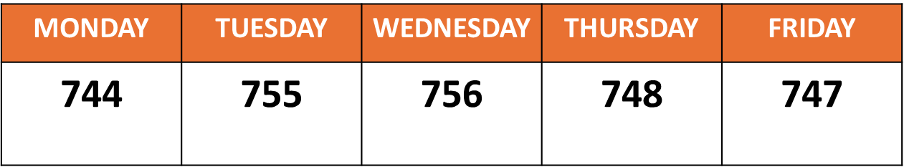
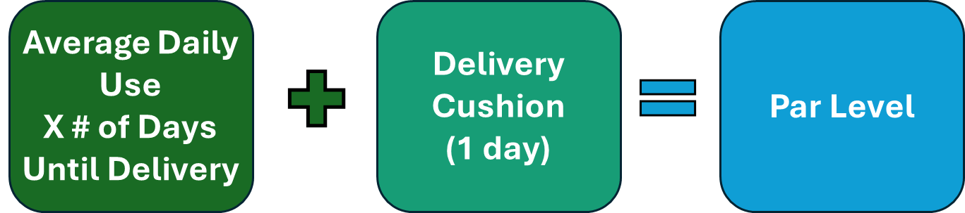
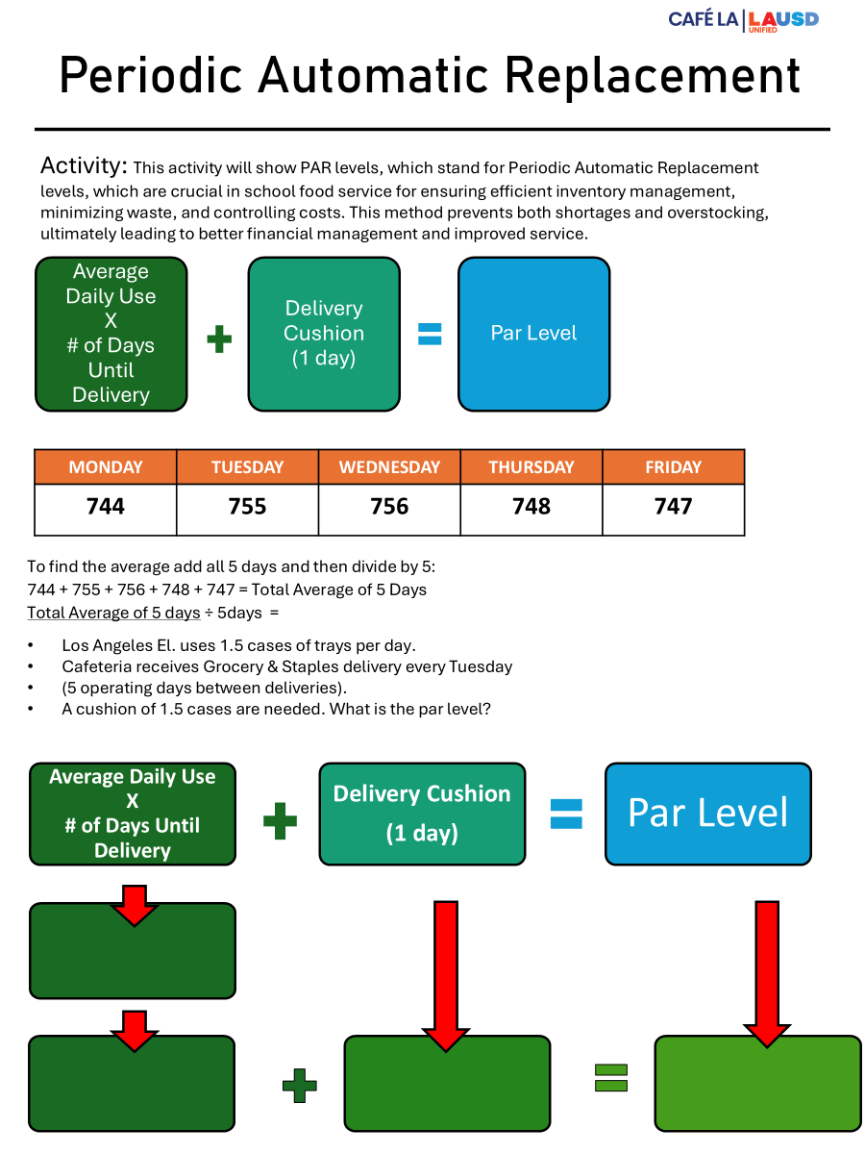
Ordering Using PAR Levels
A PAR (Periodic Automatic Replacement) level refers to the minimum quantity of a specific item required to consistently meet anticipated demand over a defined time-period, such as a week or a standard delivery cycle.
To complete Activity on next slide, use your Activity Sheet to follow along.

Slide 30
Activity - PAR Level Step 1
Complete the formula below to find the average weekly servings to determine the PAR level when ordering.
Add all meal counts and then divide by number of days.
MONDAY | TUESDAY | WEDNESDAY | THURSDAY | FRIDAY
744 | 755 | 756 | 748 | 747
744 + 755 + 756 + 748 + 747 = 3,750
3,750 ÷ 5 days = 750 lunches per day

Slide 31
Activity - PAR Level Step 2
Los Angeles El. uses 1.5 cases of trays per day; they come 500 trays per case. They receive a Grocery & Staples delivery every Tuesday
(5 operating days between deliveries).
A 1-day supply delivery cushion of 1.5 cases are needed.
Average Daily Use
X
# of Days Until Delivery
Delivery Cushion
(1 day supply)
Par Level
What is the PAR level for the week?
(1.5 X 5)
7.5 cases
1.5 cases
9 cases

Slide 32
Financials
&
Managing
Budgets
Forecasting
&
Ordering Food
Meal Counts

Slide 33



Missing Meal Counts
What do meal counts represent?
Revenue
Missing meal counts equate to no revenue. All meals must be recorded promptly no later than the next business day.
MONDAY | TUESDAY | WEDNESDAY | THURSDAY | FRIDAY
744 |  | 756 | 748
Food Service Division is the School Food Authority for LAUSD and is a self-sustaining food operation.
The School Food Authority will be contacted and held accountable for missing meal counts.
Notes:
Your Cafeteria Info sheet should be updated yearly or as average daily participation

Slide 34





Meal counts are NOT submitted for reimbursement.
Meal counts that are not entered into MCS contribute to the loss of revenue from State and Federal funds.
What happens when meals are not properly claimed?
Manager does NOT enter meal counts in MCS.
Students receive non-reimbursable meals.
Notes:
TELL: Here is the process if a site fails to input their meal counts in CMS.
(Click and read each step)

Slide 35
Financials
&
Managing
Budgets
Forecasting
&
Ordering Food
Meal Counts
Receiving
Accurately

Slide 36
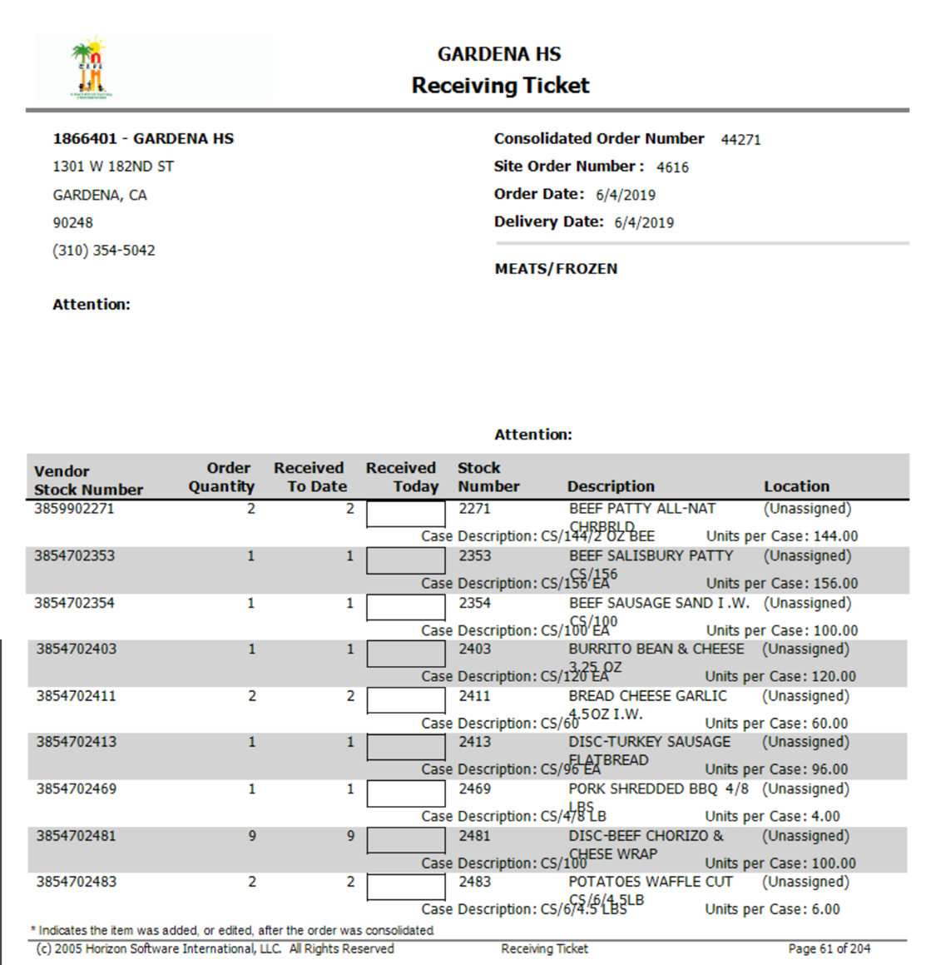



Receiving Tickets
Follow the Ordering Calendar to print Receiving Tickets.
If substitutions or items delivered are not listed on the Receiving Ticket those items must be manually added/deleted on:
  Receiving Tickets
  Vendor Invoices
  CMS
2
Chicken Pattys
1
1
1
2
1
3/17/23
1
3/17/23
3/17/23
9
3/17/23
3/17/23
3/17/23
2
3/17/23
3/17/23
3/17/23

Slide 37
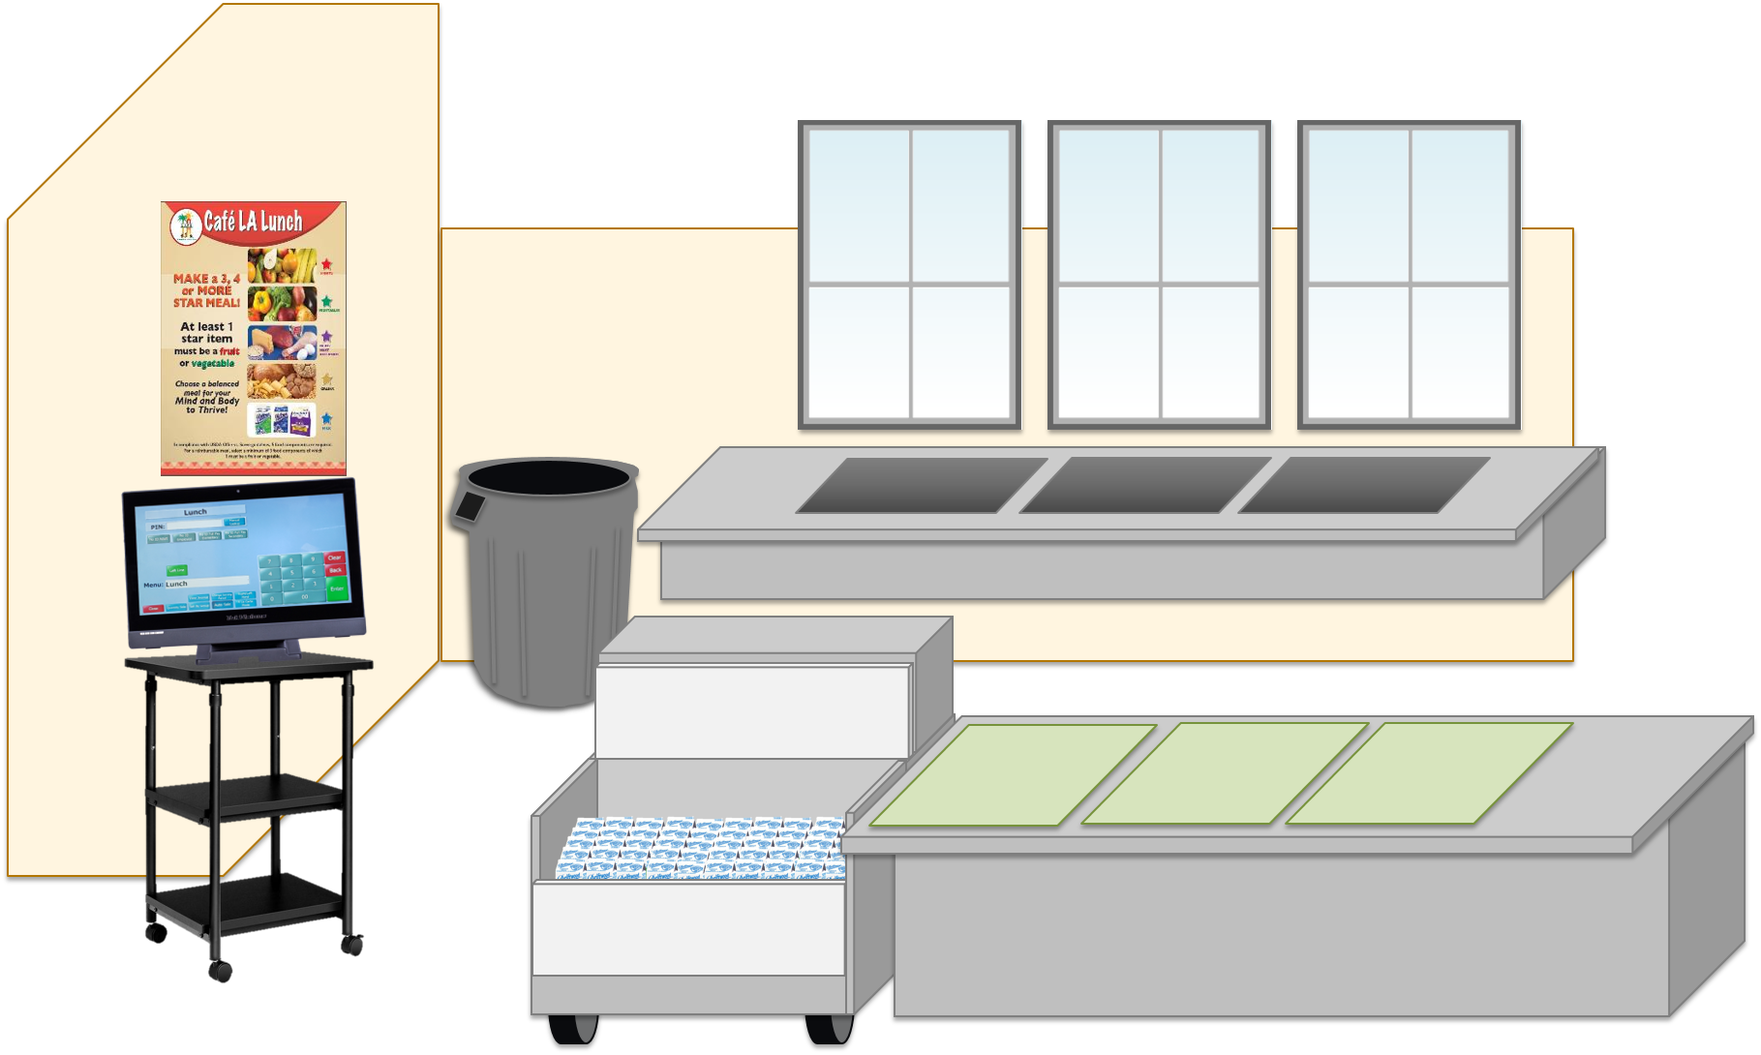


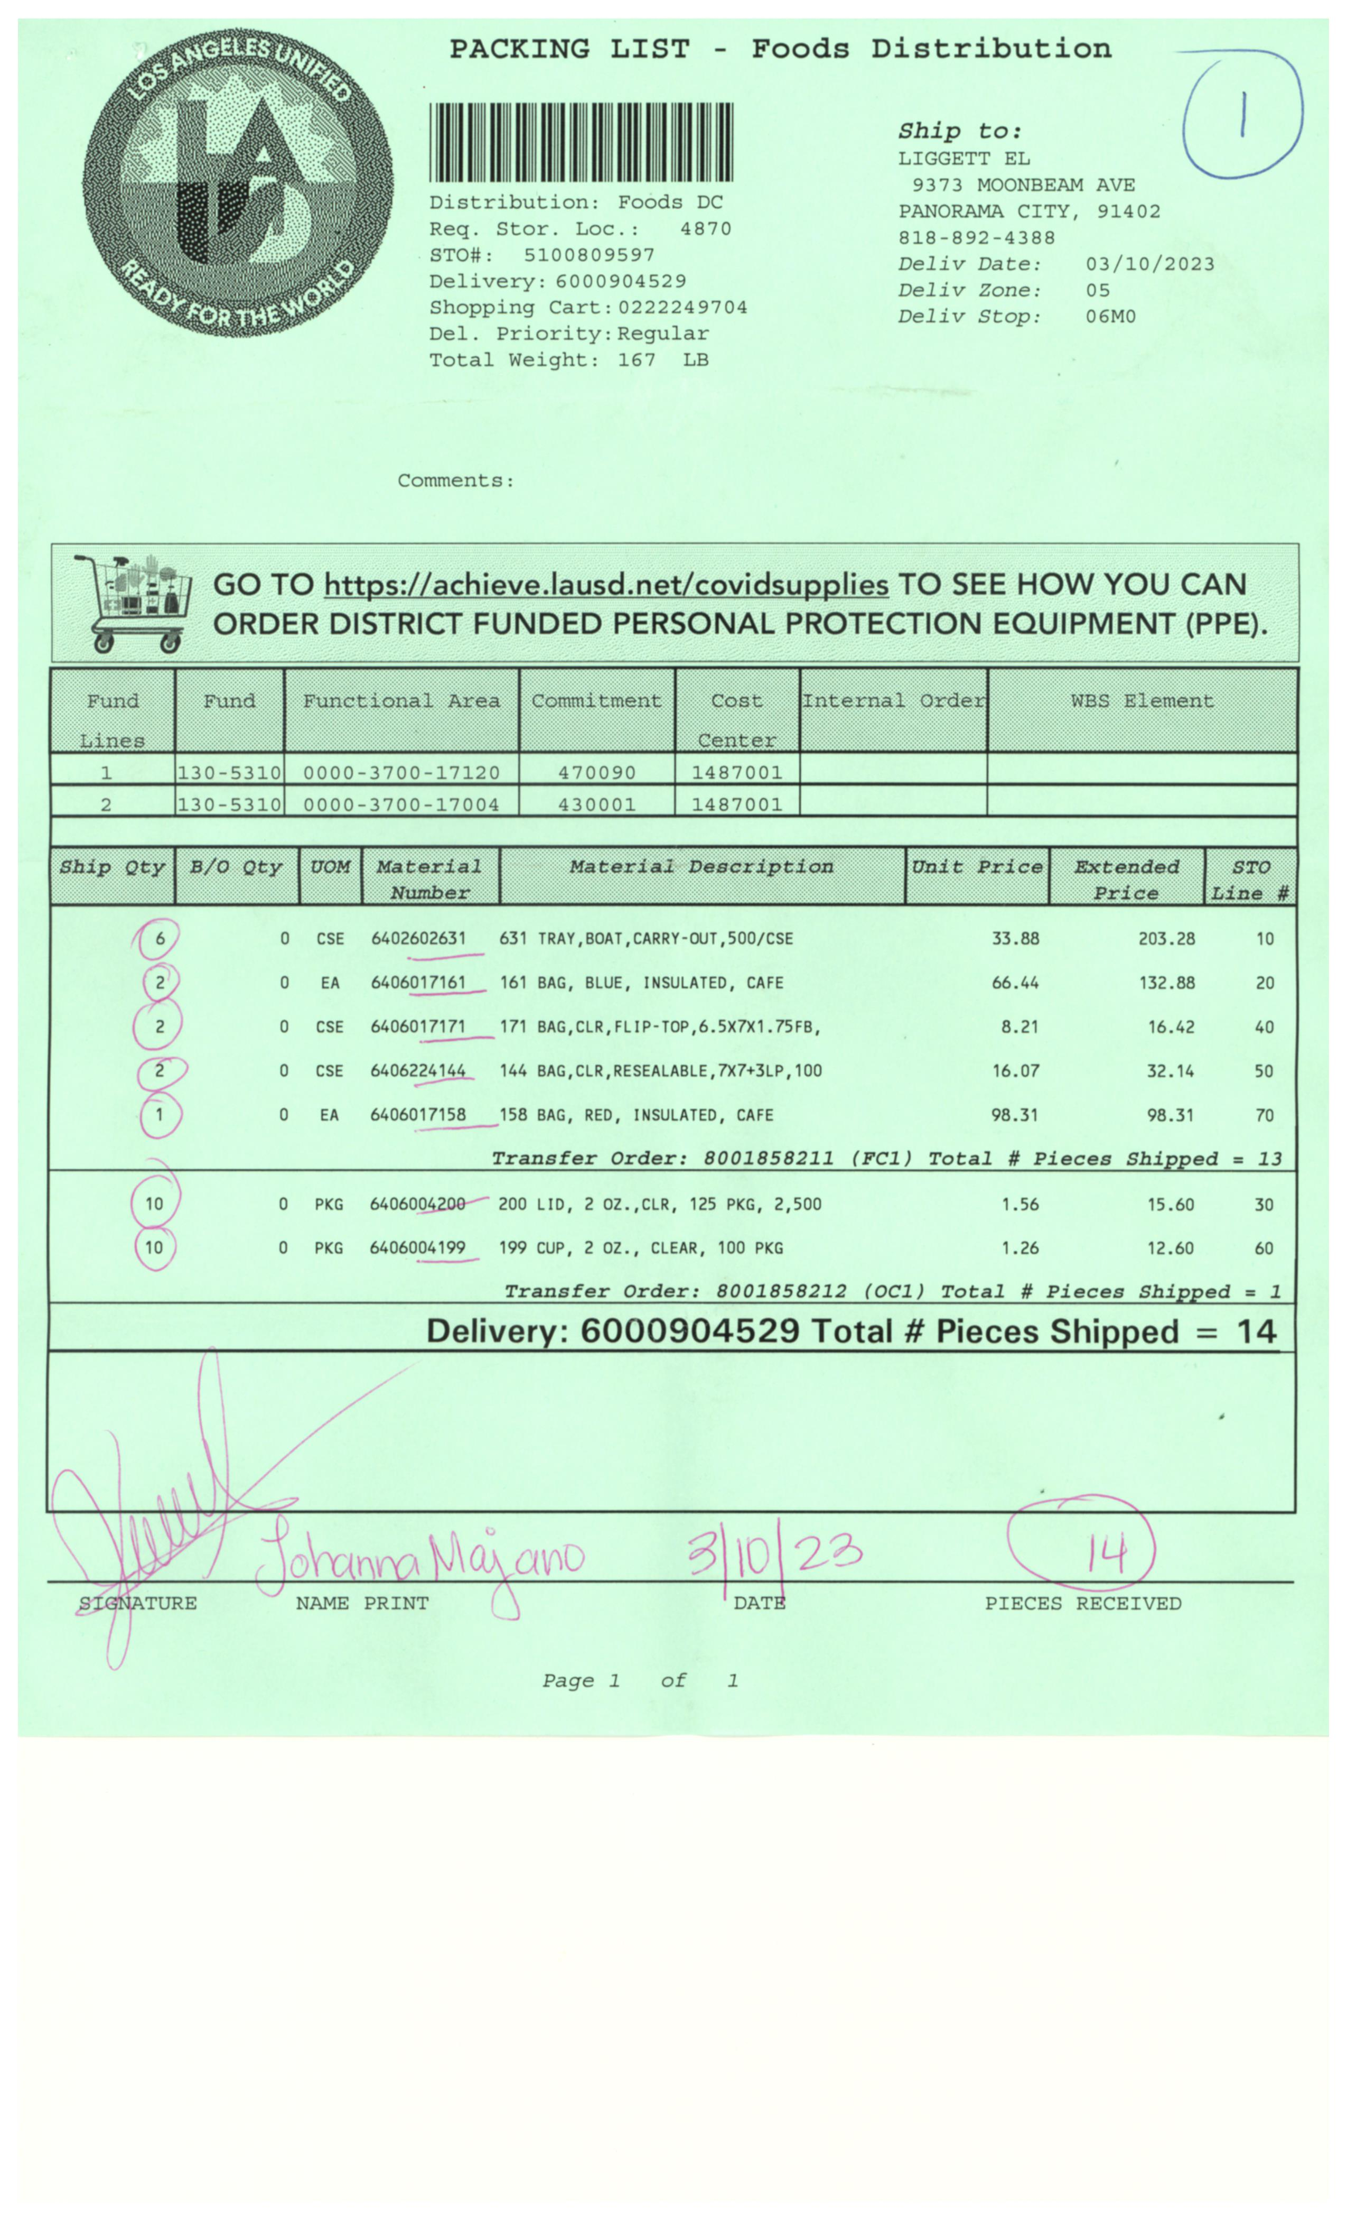
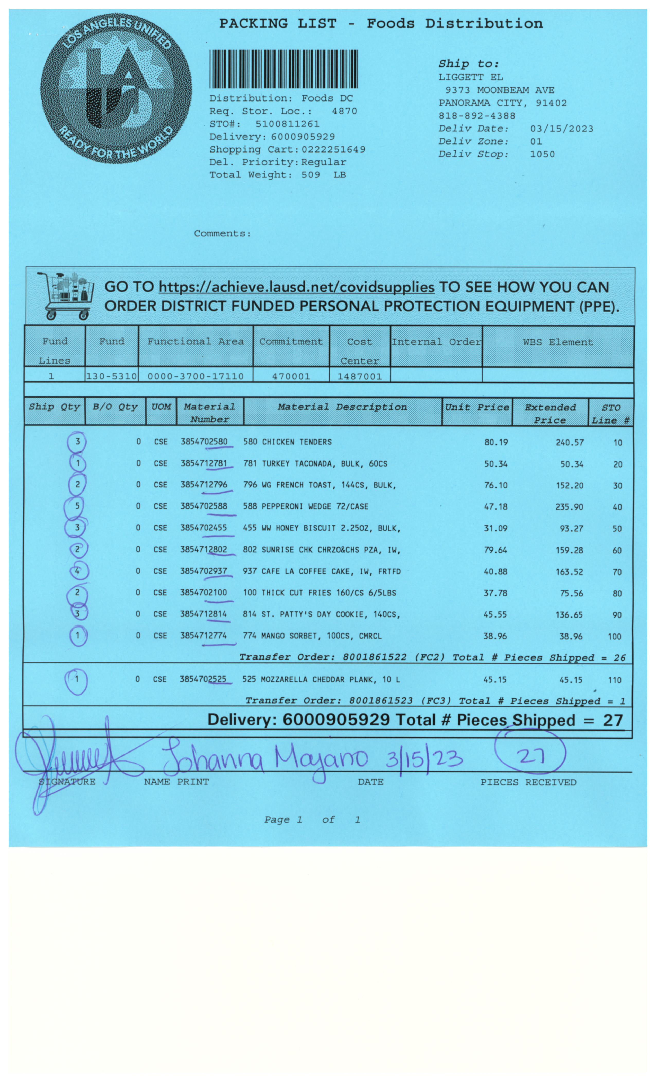
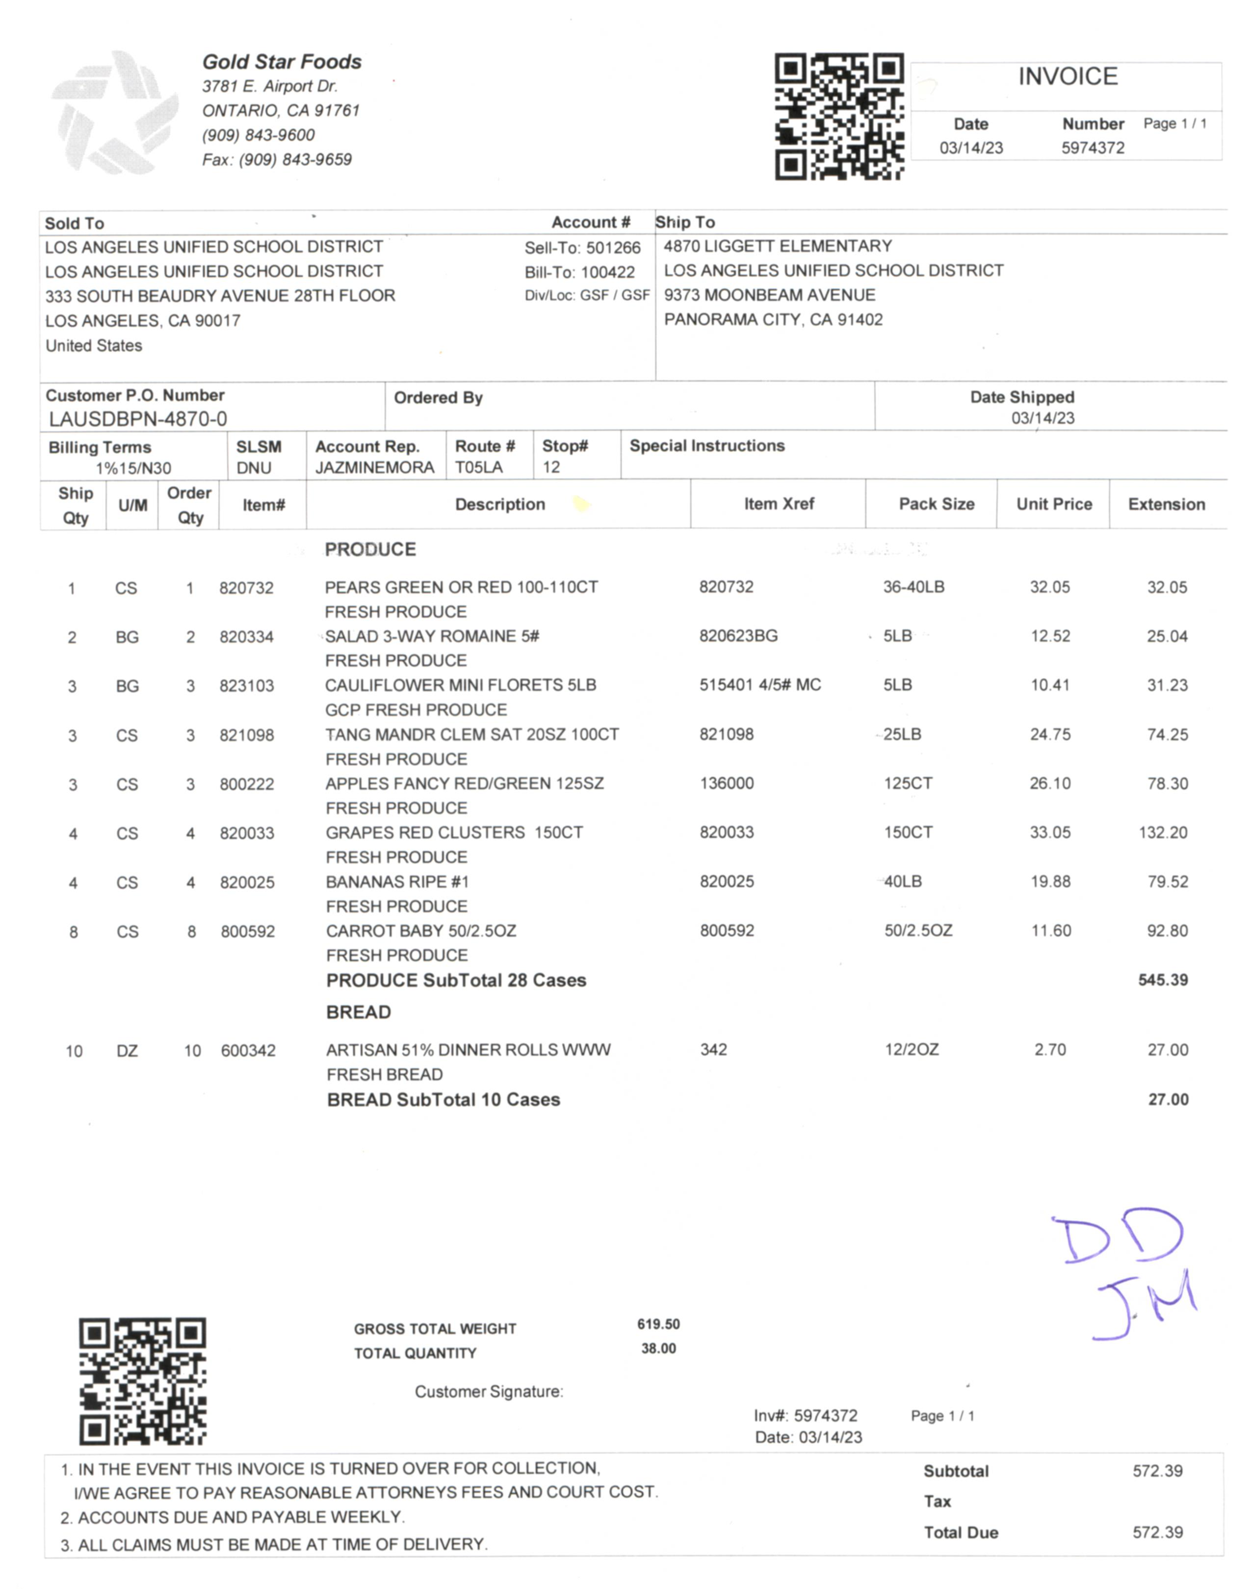
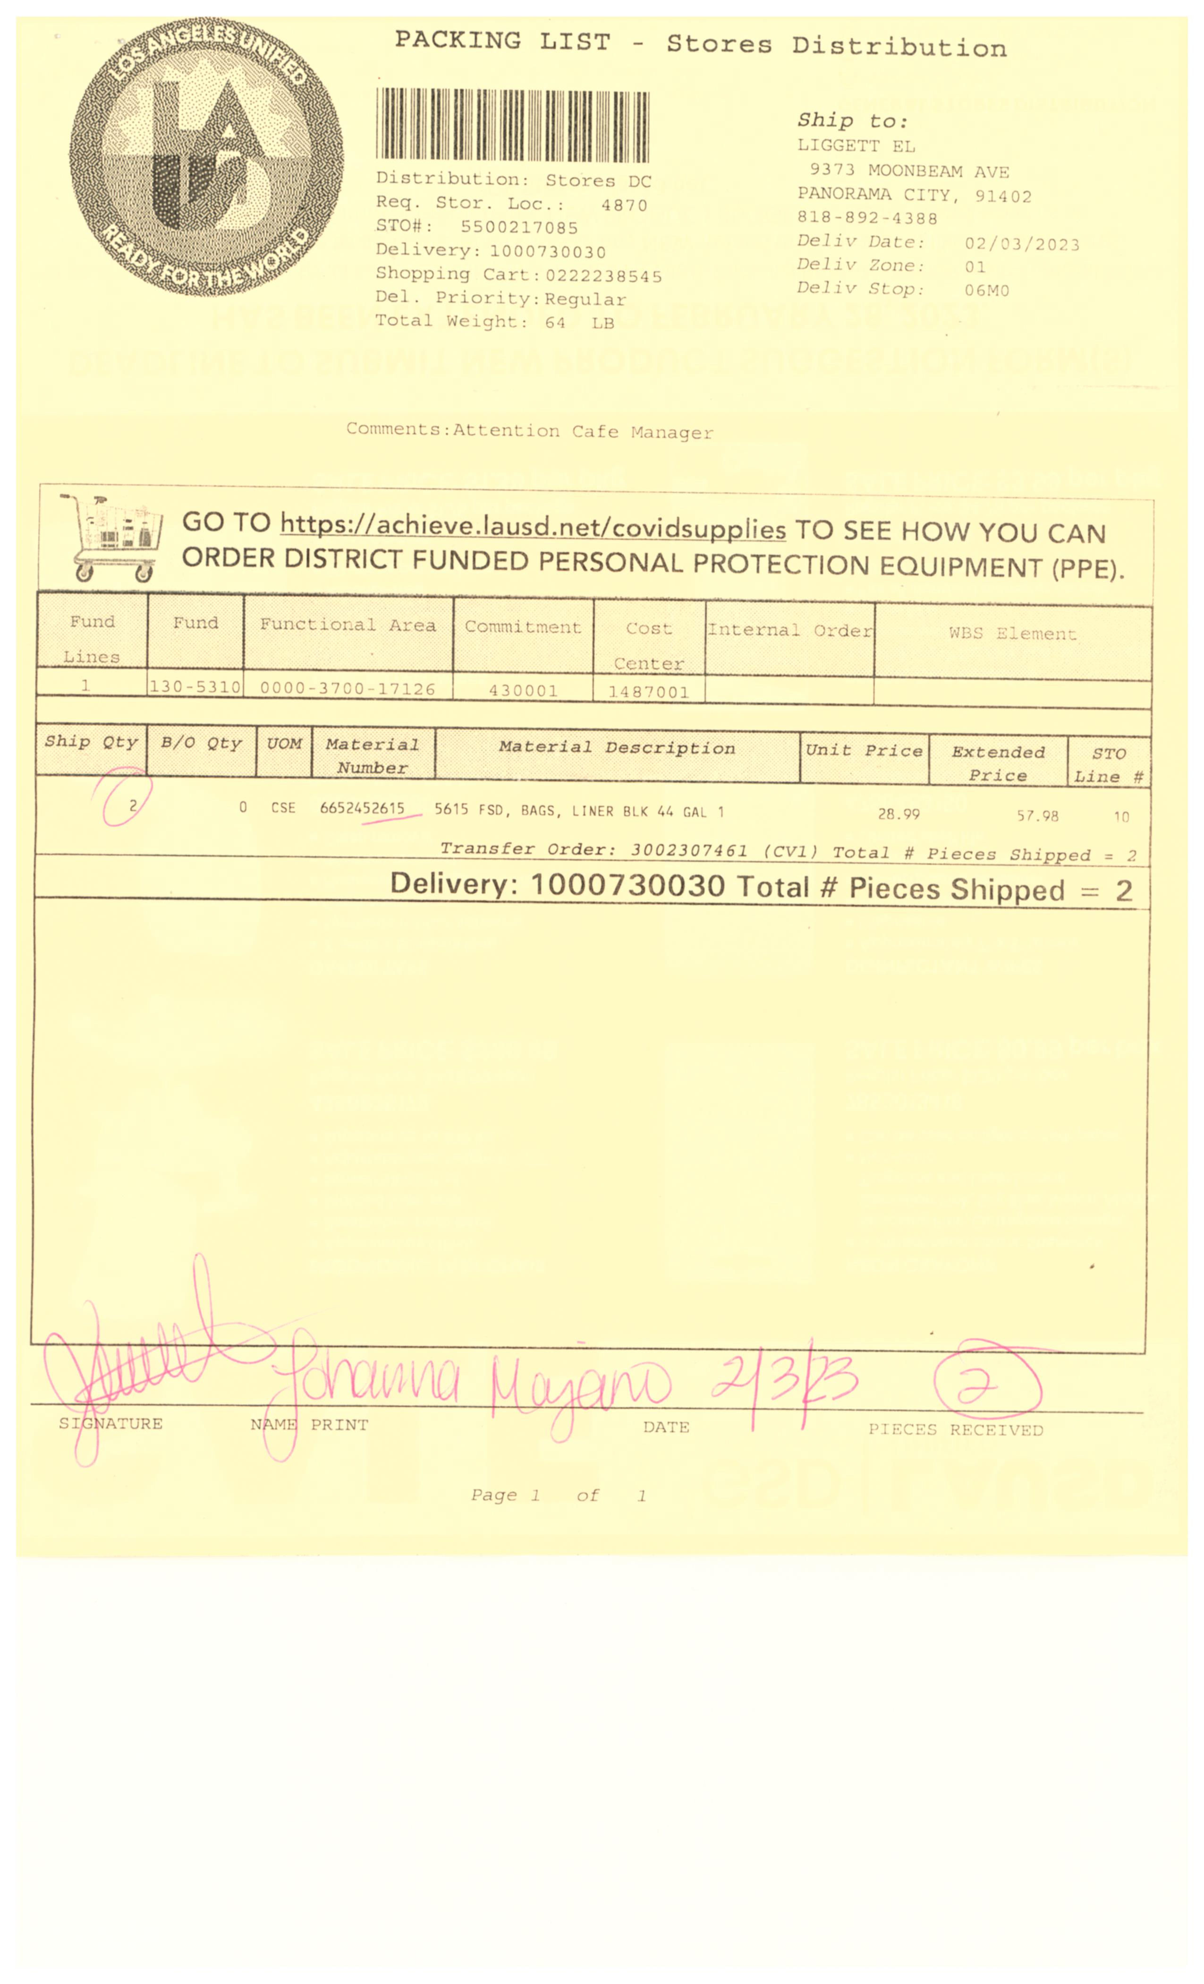
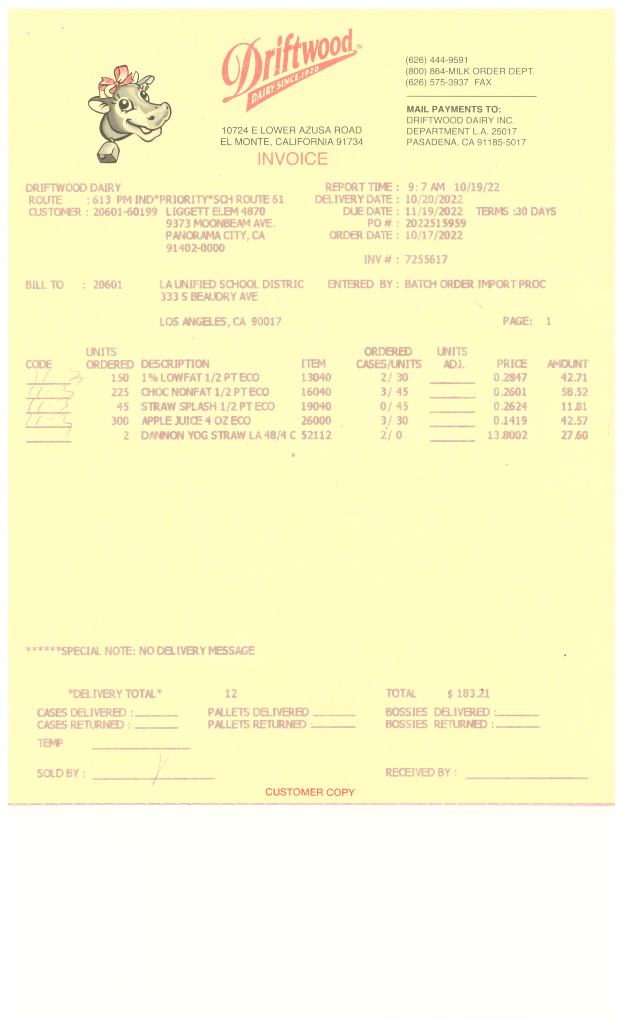



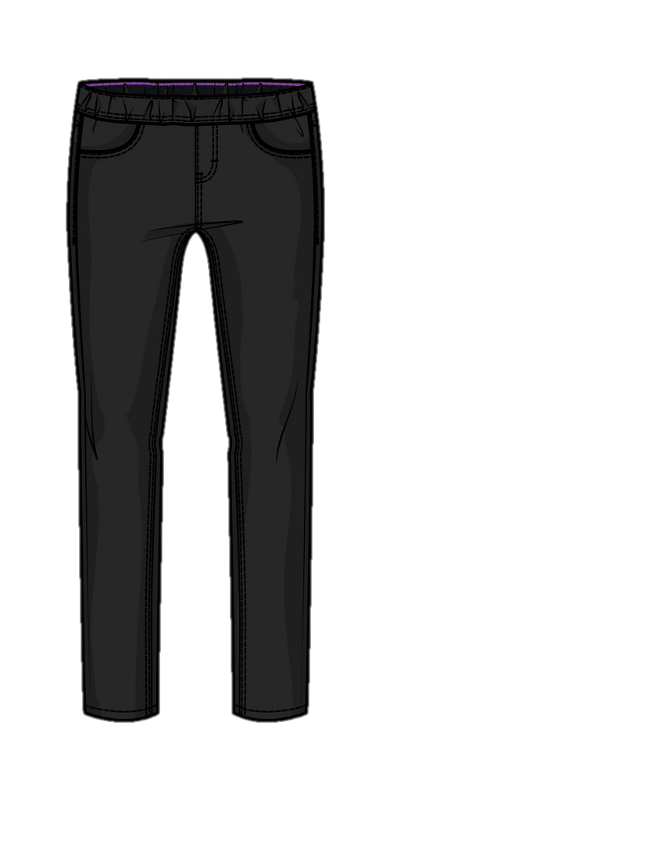


“Vendors
are not paid until invoices are accurately received into CMS.”
“If we forget to pay our light bill,
we will have no lights!
Same goes for each of our vendors.”
“Always remember, Vendor Invoices
are a
bill of sale
not a receipt”
“Uh oh, did we forget to pay our light bill!”
“Bills must be paid
on time.”
Vendors:
Food Service Warehouse
Goldstar Foods
Driftwood Dairy
Clearbrook Farms Dairy
Notes:
1 % - 1.5% grand bonus of 1 million for all receivers accurately in system and paid in a timely manner to the vendors.

Slide 38
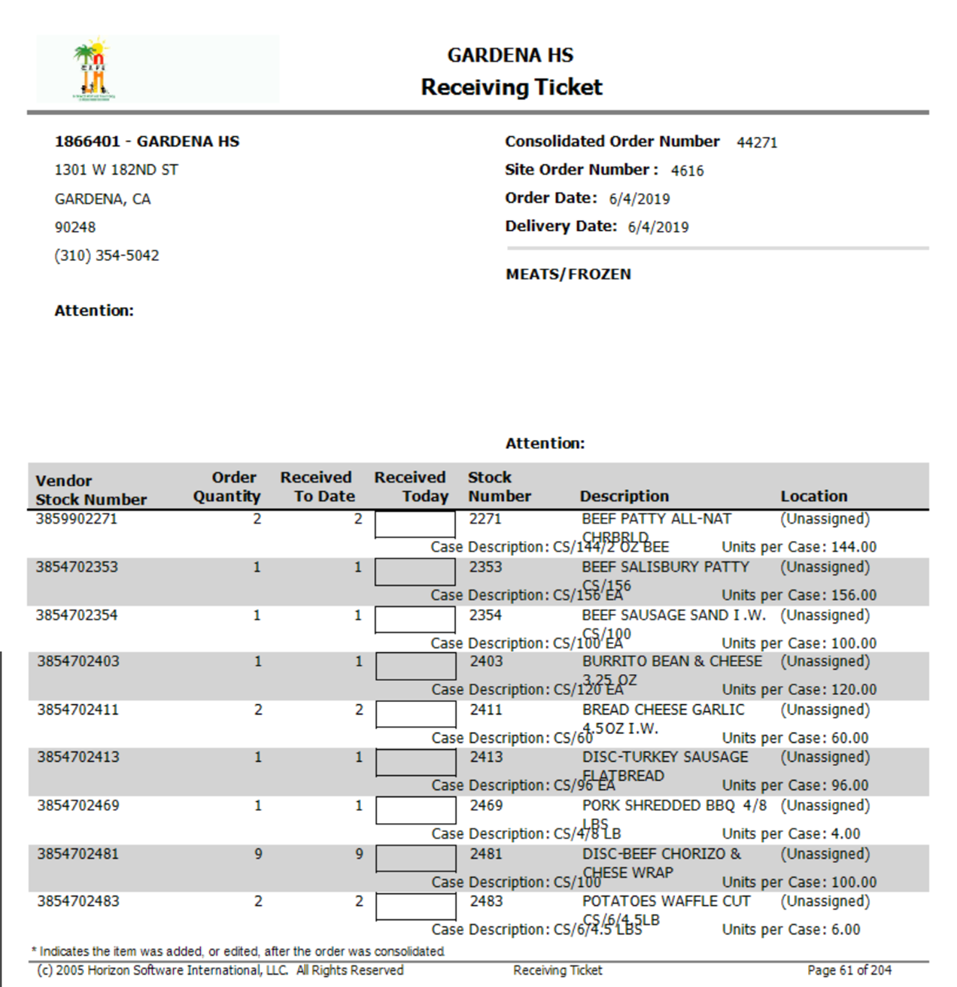
Attention to Detail
Accurate receiving and inventory tracking rely on attention to detail.
Small discrepancies lead to costly errors in billing and inventory.
Ensure the following numbers match exactly for each item received on:
Material numbers on Vendor Invoices
Vendor stock numbers on Receiving Tickets
2
3859902271
777 Beef Patty All-NAT

Slide 39
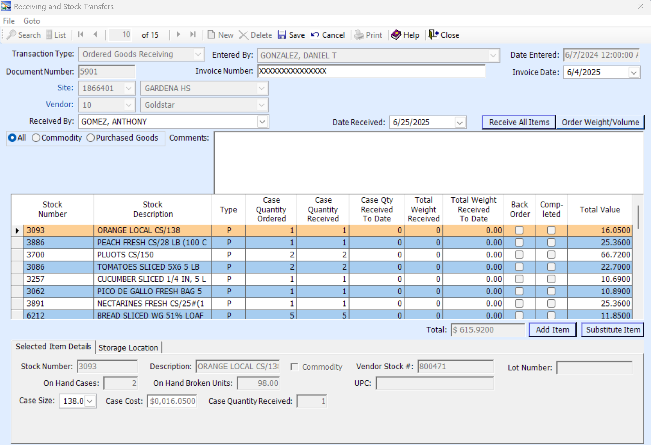
Check For Accuracy
When entering invoices into CMS, avoid clicking Receive All Items
Input all Vendor Invoice information when receiving into CMS, such as:
A.
D.
B.
C.
Invoice number
Received by
Date Received
Invoice date
Case quantity received
E.

Slide 40
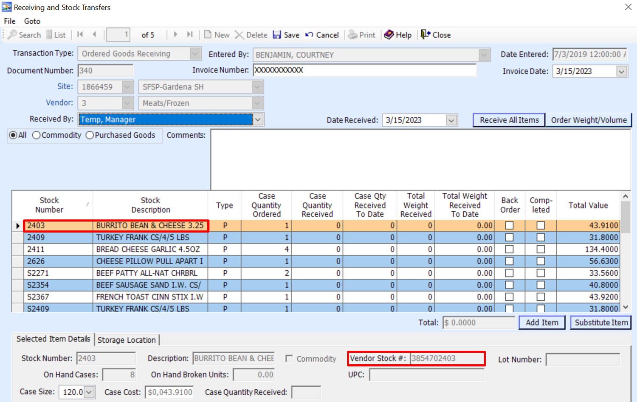
Accurate Receiving Into CMS
Verifying food and supplies upon receipt is a vital step in ensuring the financial solvency of school food operations.
Use the Receiving Ticket and Vendor Invoice when inputting received goods into CMS.
Always verify Vendor stock numbers match, especially when substitutions occur for similar items. This ensures correct item is received.
3854702403
777 Burrito Bean & Cheese.

Slide 41
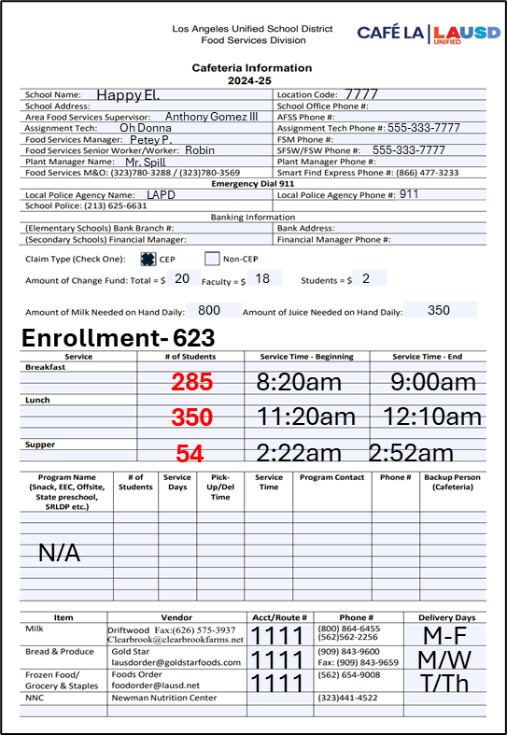
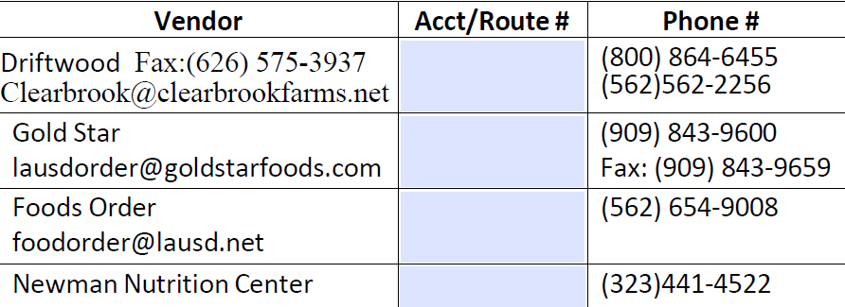





Requesting Credit
To request credit for delivery discrepancies; missing items, damaged boxes, substitutions and spoiled items.
Day Deliveries – Communicate with the delivery driver and request a Discrepancy Report. Complete and email a Quality Control Form to the Nutrition Specialist assigned to your region.
Night Deliveries - Complete and email a Quality Control Form to the Nutrition Specialist assigned to your region and contact vendor for credit.

Slide 42
Café LA Compass
Forecasting
&
Ordering Food
Receiving
Accurately
Financials
&
Managing
Budgets
Meal Counts
Managing Inventory

Slide 43
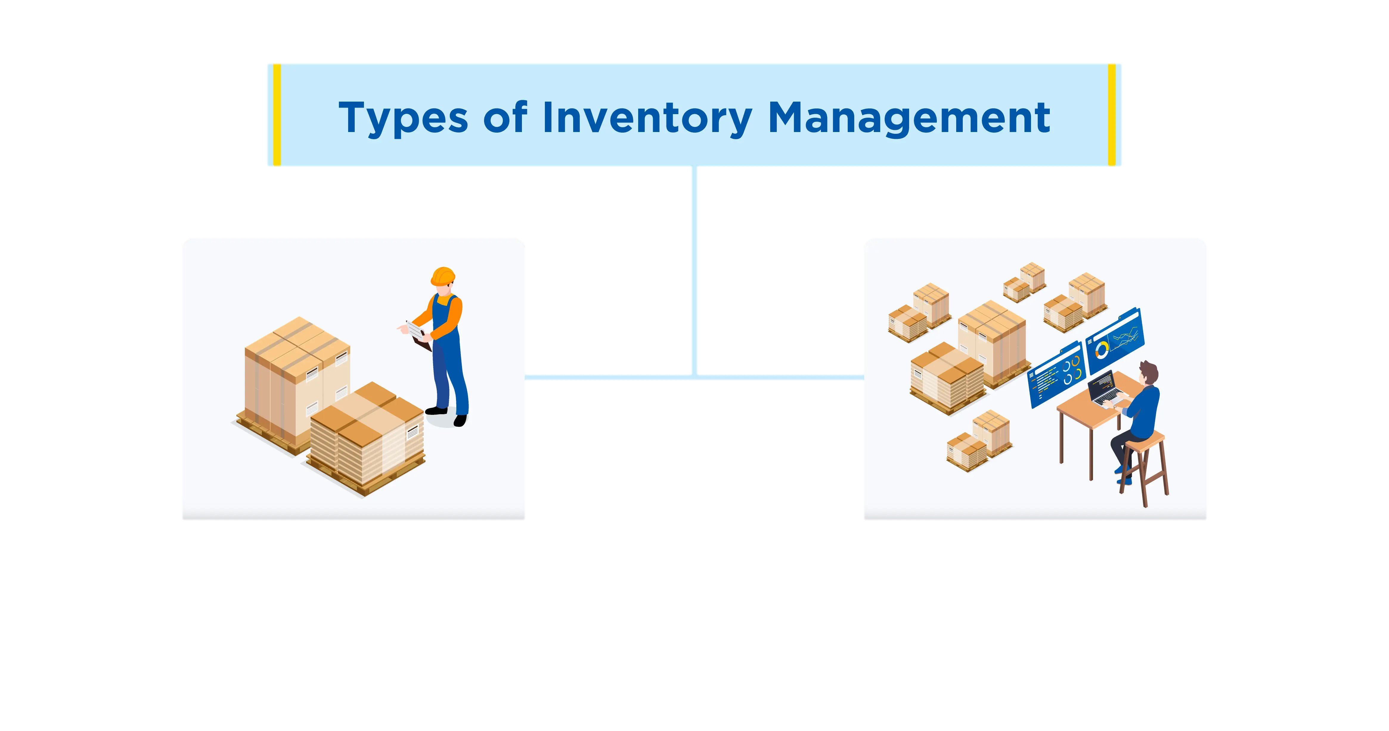

Perpetual Inventory
Perpetual inventory is a system that continuously tracks inventory in real time using technology.
  As food operations is underway, inventory counts update in real time as items are received, used, served, sold, and returned to stock
  Provides up-to-date counts without needing frequent full physical inventories
  Reduces stock discrepancies by showing real-time data on what items are available on hand
Notes:
Why It Matters in School Food Service
Inventory updates instantly whenever items are received, used, or sold.
Provides up-to-date counts without needing frequent full physical inventories
Reduces stock discrepancies by showing real-time date on what’s on hand

Slide 44




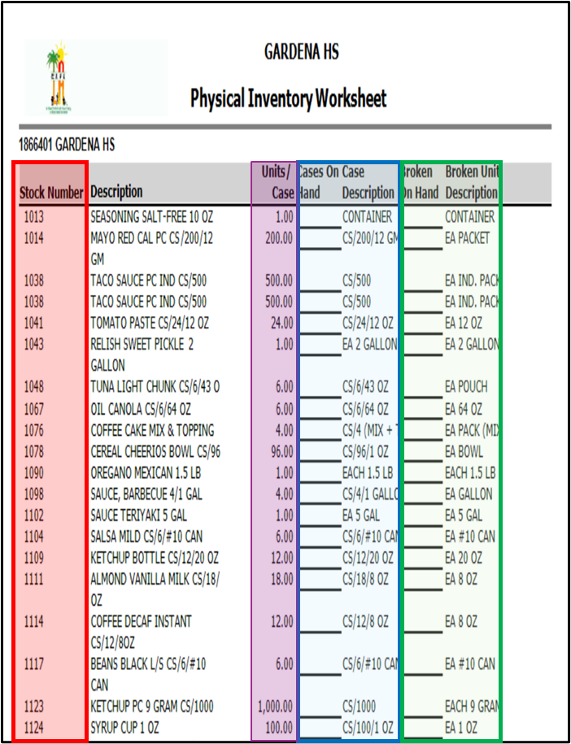
Physical Inventory
Physical inventory is the process of counting and verifying the actual stock of goods held within the storage of the operation.
Physical inventory is conducted at the end of the month “last working day.”
Count each item of inventory in stock
Manually record amounts on the Physical Inventory Worksheet
Input into CMS Back of the House

Slide 45
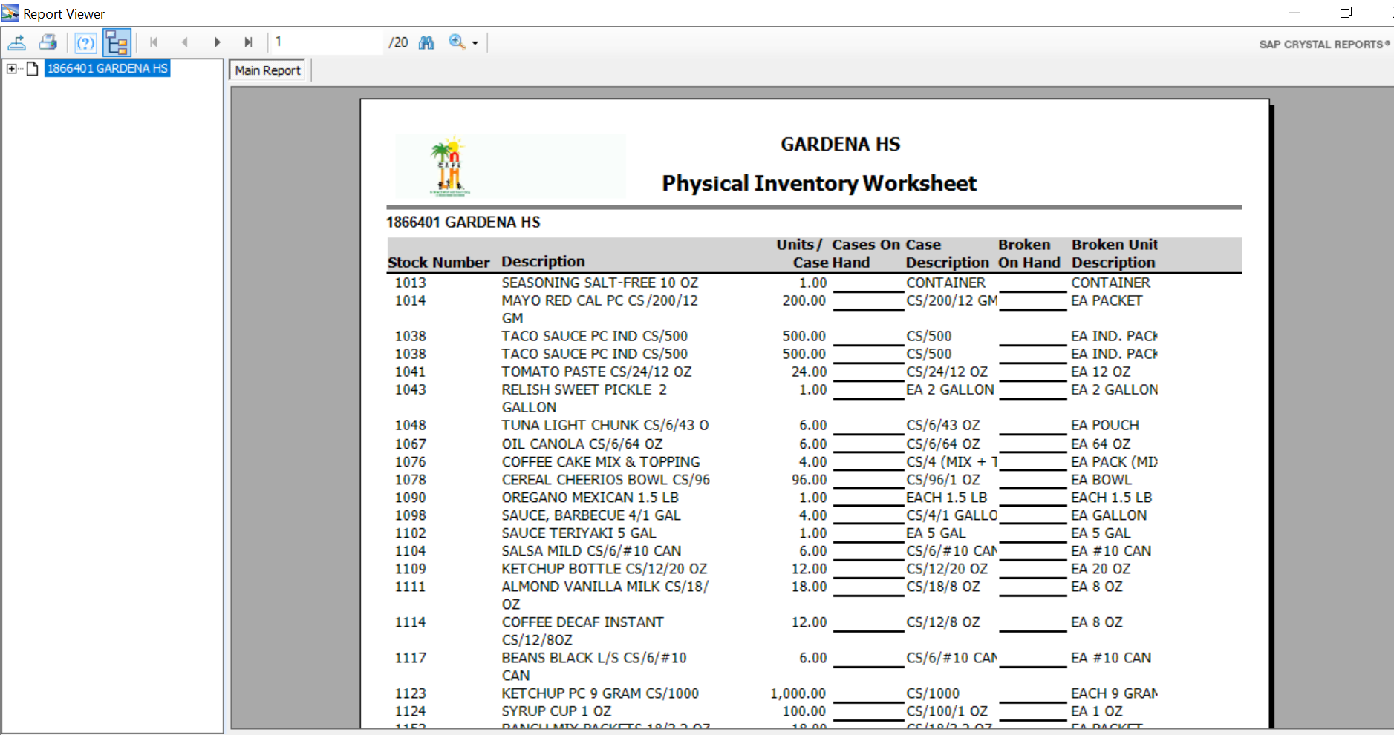
Physical Inventory Worksheet
The Physical Inventory Worksheet consists of all food and supply items along with the stock numbers.
Print a copy of the Physical Inventory Worksheet prior to conducting the physical inventory of all items on hand.
Notes:
The “Physical Inventory Worksheet” allows you to easily track all items available to order from the warehouse by their “Stock Number”, as a result this allows you to use the Quick Entry Method when inputting your Physical Inventory.
Its vital you pay attention to the Units Column.
If the number of units is equal to 1 then all broken quantities will be entered as a Decimal, (.25, .33, .50, .75).
If the number of units is 2 or more, then all broken quantities will be entered as a Whole Number pertaining to the broken amount leftover (7, 15, 23, 50, 102, 1005).

Slide 46
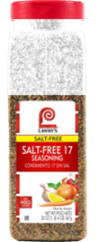
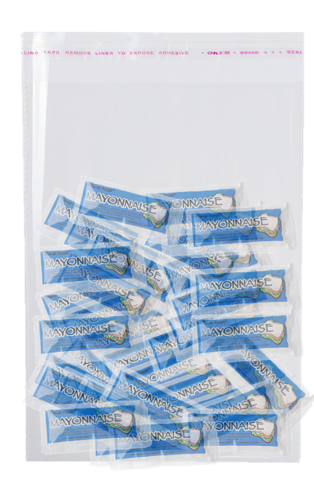
Entering “Units/Cases” On The Physical Inventory Worksheet
Use the “Units/Cases” description on Physical Inventory Worksheet to determine if broken quantities are entered as a whole number or decimal.
Unit Per Case = 1.00
.75
Use a decimal for
“broken on hand” quantities
Unit Per Case = 2.00 or more
Mayonnaise
127
127
Use Whole Number for
“broken on hand” quantities

Slide 47
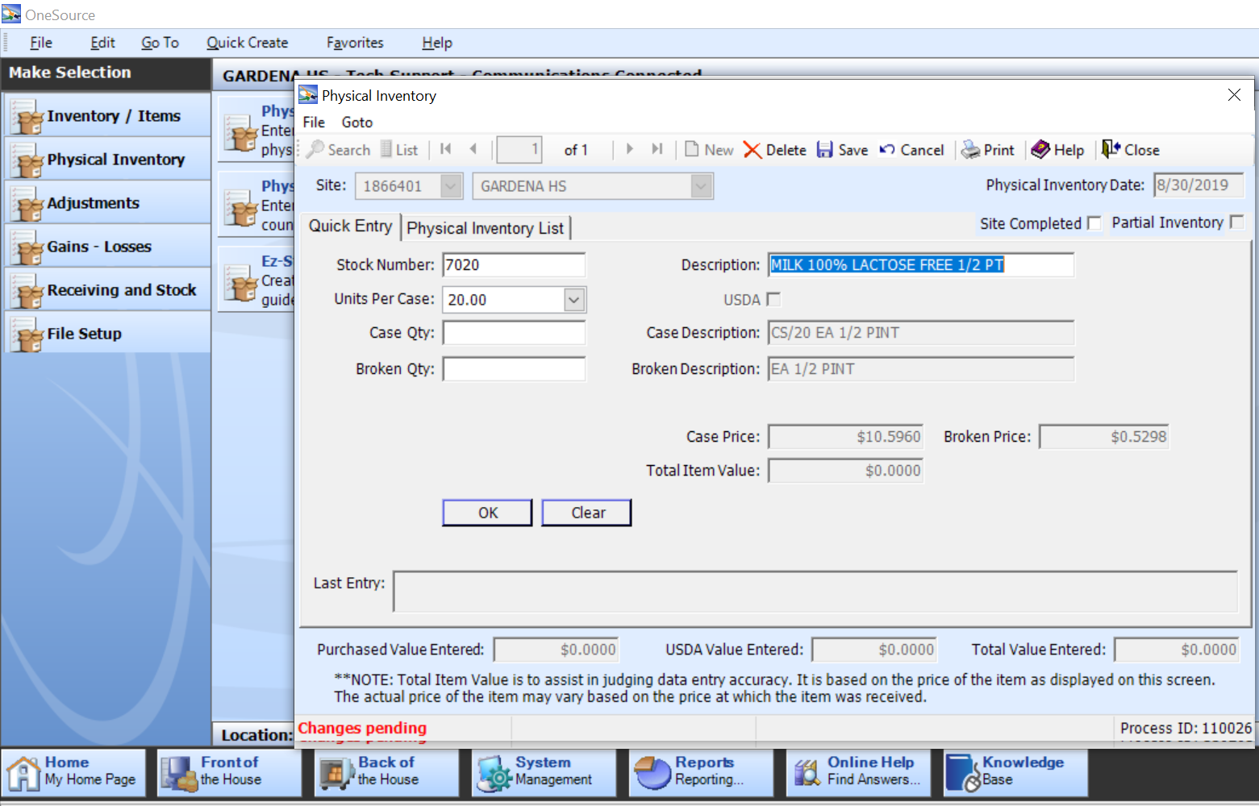
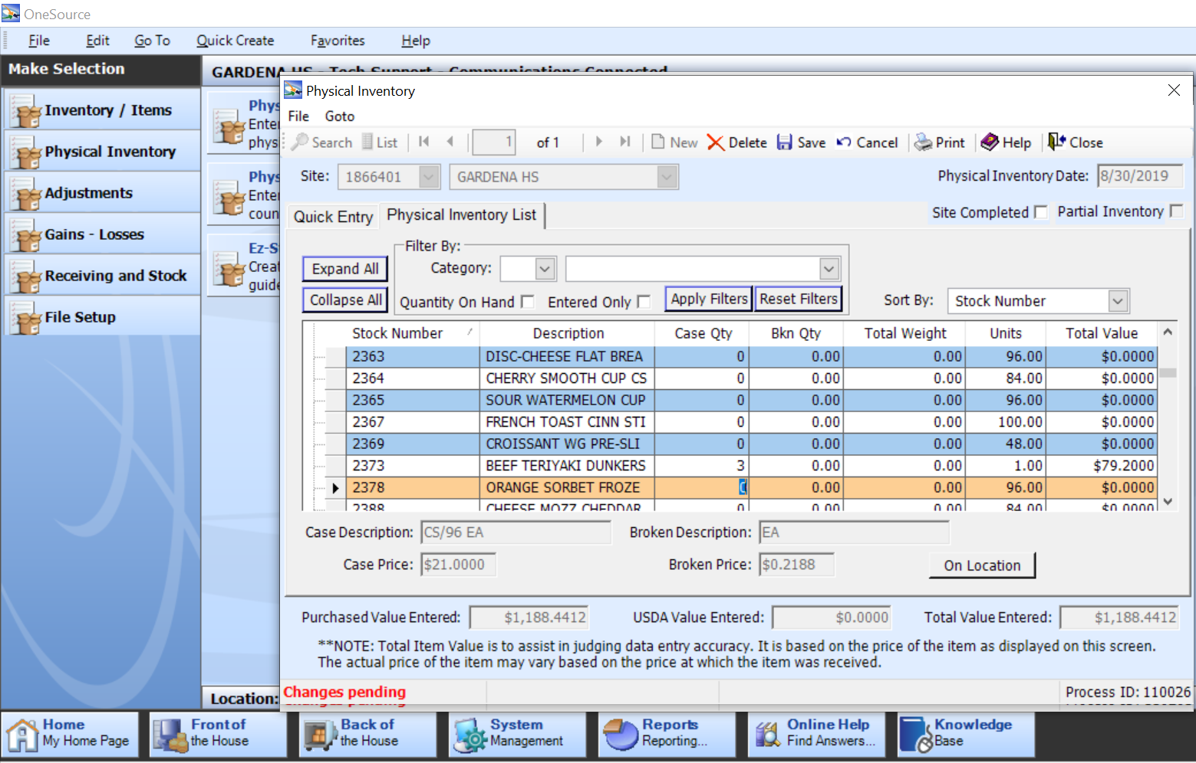
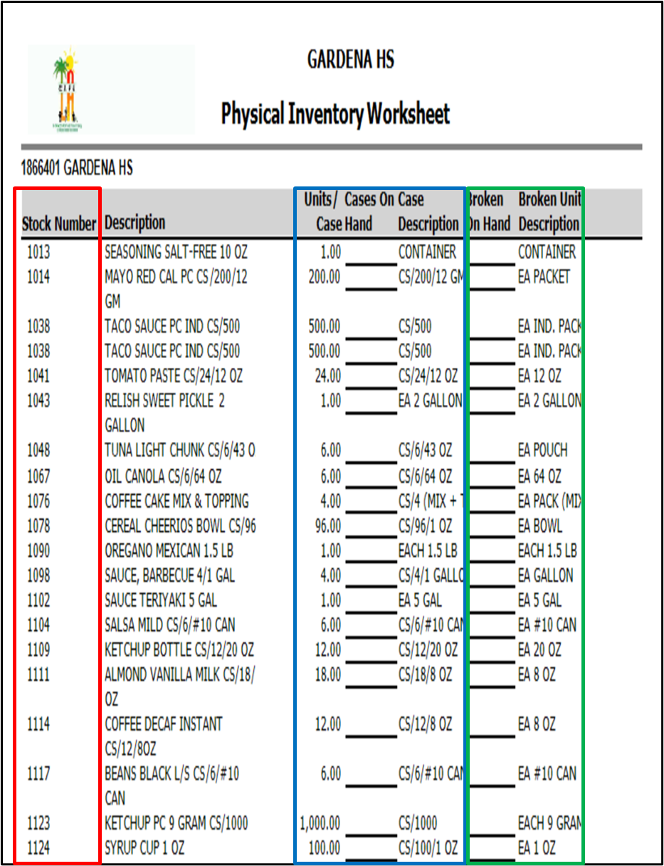
Quick Entry & Physical Inventory Methods
Quick Entry Method
Enter stock numbers and case quantities directly, without having to search through the item list.
Physical Inventory Method
Scroll through the on-screen inventory list and enter the on-hand quantity for each item.

Slide 48
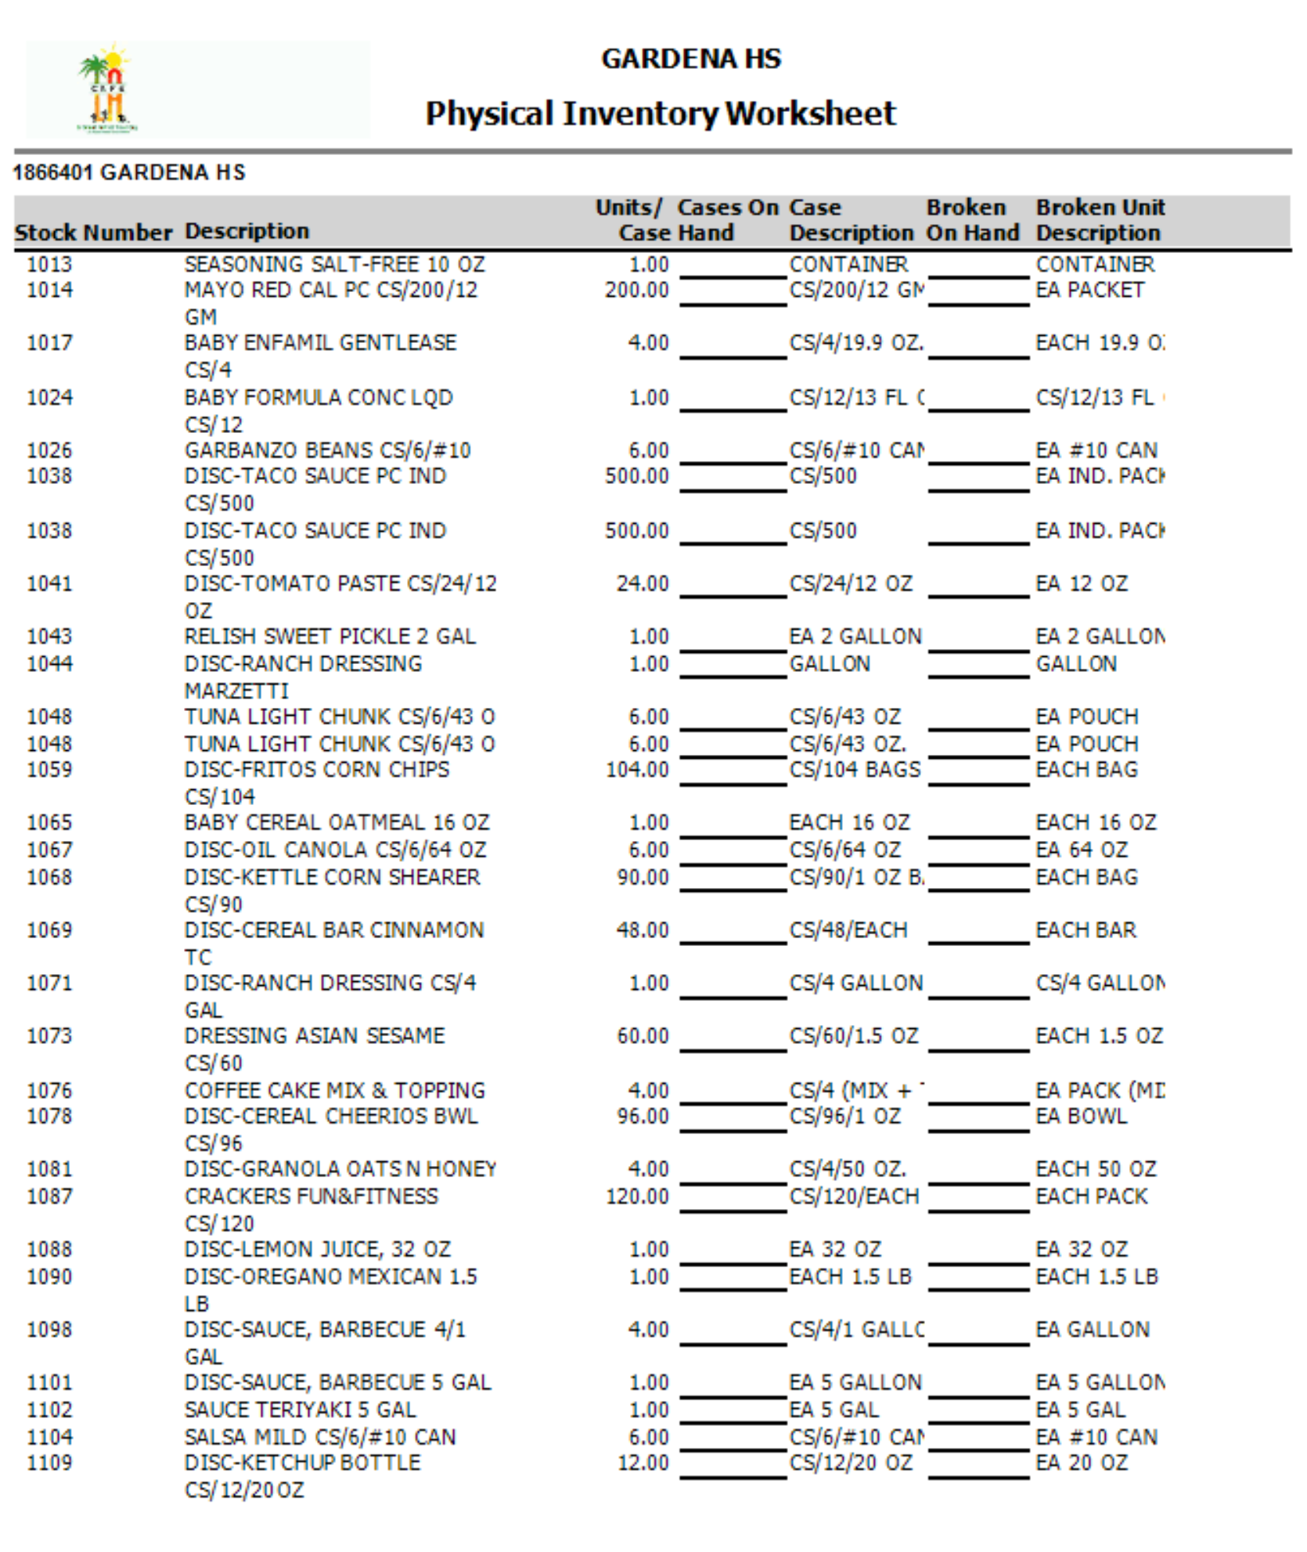
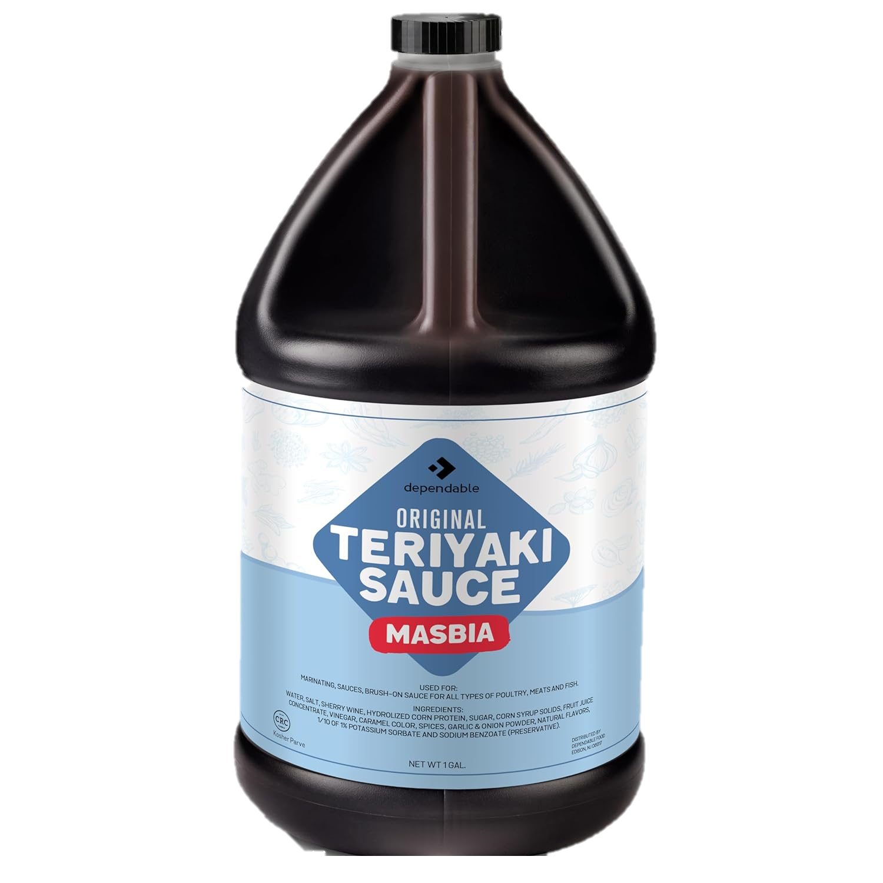
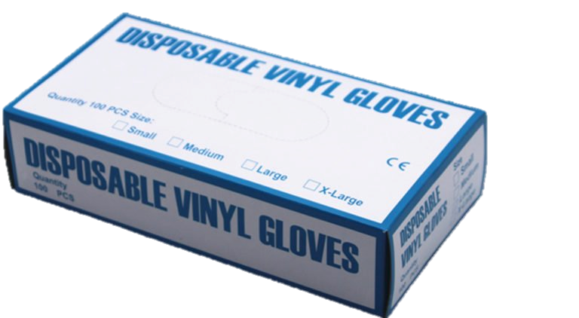
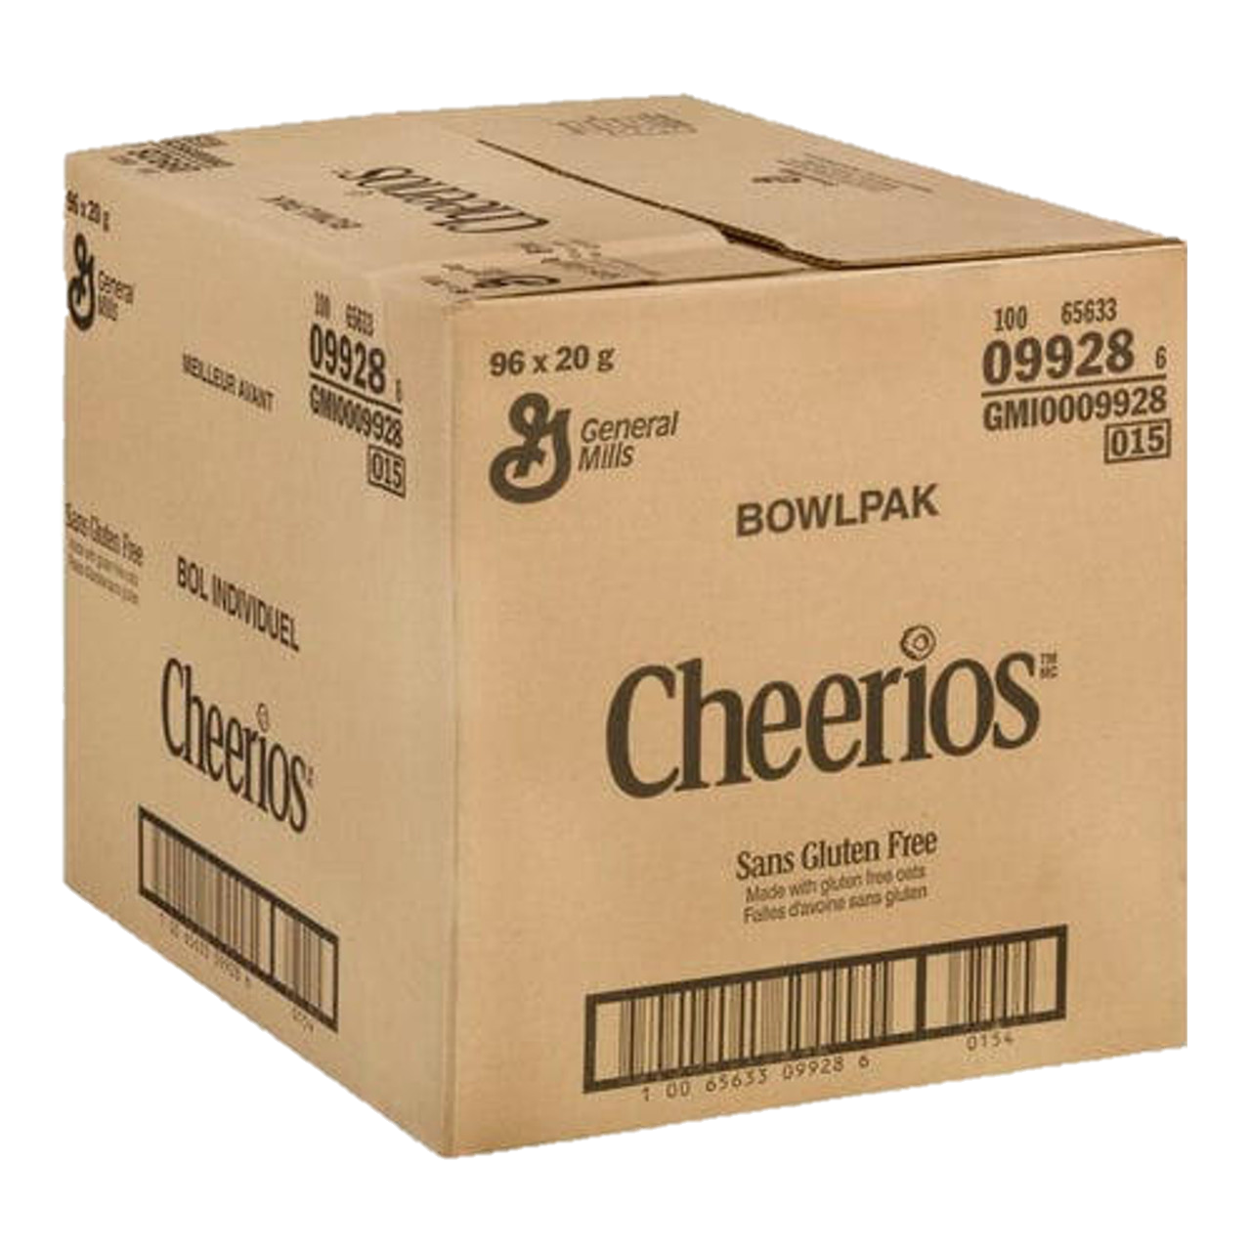
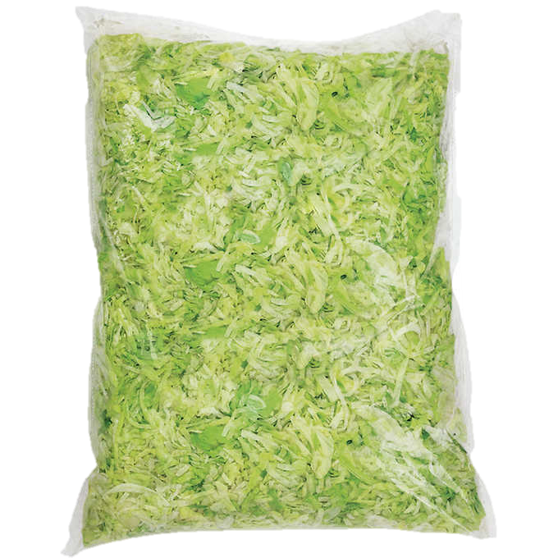
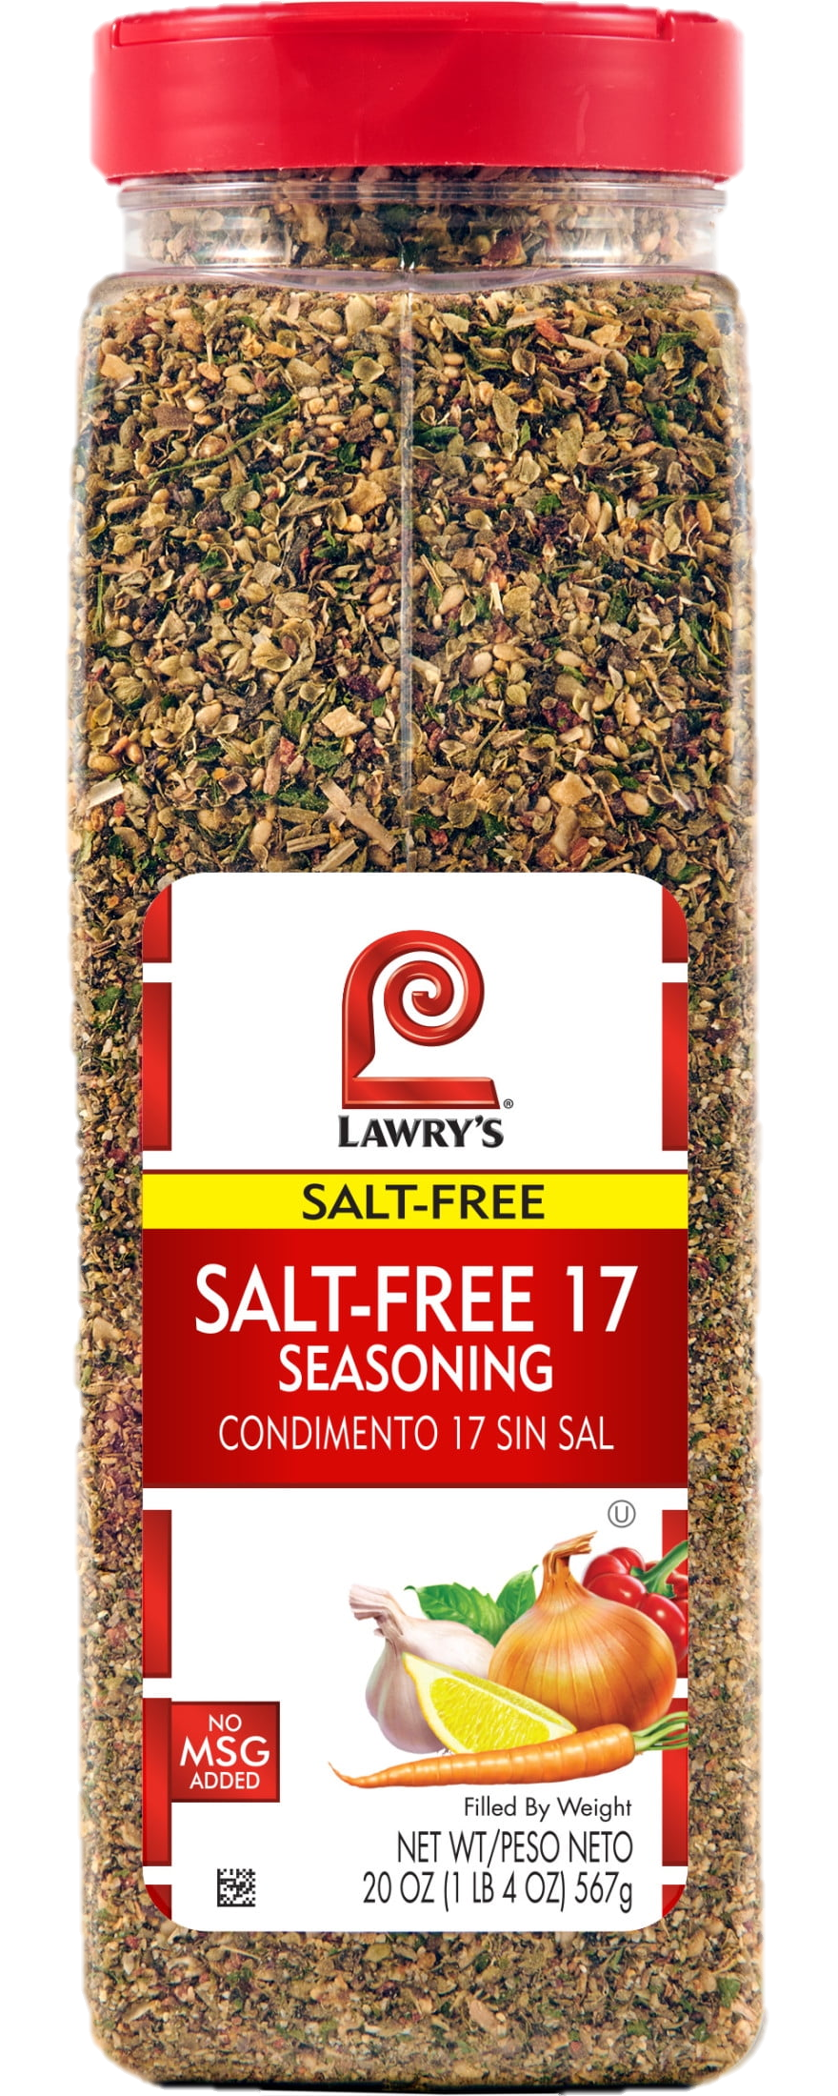
Unopen/ Unused - Whole Case Quantity
Unopen/unused cases (i.e., container, bag, box, bottle, etc.)
will be entered in “Case Qty” as a whole number
(4, 7, 10, 16, 11).
3
2
5
3
14
Notes:
When using the “Quick Entry Method” for inputting your “Physical Inventory” its important to identify the “Units Per Case”. If the number is more than 1 then in the “Broken Quantities” tab, you will input any whole number as the broken quantity.

Slide 49
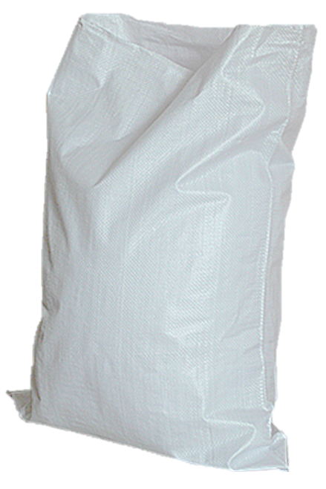
Broken Quantities
    If units per case = 1.00
    Broken quantities are entered as a decimal (.25, .50, .75)
Rice
25 lbs.
1466
`
.75
1 Case
.50
Rice Brown Parboiled 25lbs
.25
1
1
1
Bag 25 lbs.
.50
.25
.75
7

Slide 50

Inventory Common Mistakes
When entering case counts into inventory, accuracy is critical.
Central office reviews each site’s physical inventory and checks for discrepancies that inflate inventory costs.
2
20
.25
25

Slide 51


Physical Inventory Sheet Activity
Use the Physical Inventory Worksheet to enter the full and broken case quantities.
Notes:
5 minutes timer

Slide 52
Use the Physical Inventory Worksheet to enter the full and broken case quantities.
Notes:
5 minutes timer

Slide 53
Answer Sheet
Description
Cases On Hand
Broken On Hand
2 .75
Seasoning Salt
10oz
2 .75
4 11
Relish
3
Tuna Light
2 3
Cheerios
3 4
3
Teriyaki
Sauce
2 .75
2 3
Mayo
4 11
3 4
2 .75
1123

Slide 54


Completing Inventory
Once all Physical Inventory case counts have been input into CMS:
Review total value entered
If the total value entered is excessive, the case quantity could be entered incorrectly.
Once all case counts are input and total value amounts are verified and correct,
Click “Site Complete” and “Save”

Slide 55
Do these ents
Make ense ?

Slide 56


Raffle
Time!

Slide 57
“When the top increases, it is easier to flow money to the bottom-line” – Manish Singh

